Slide 1
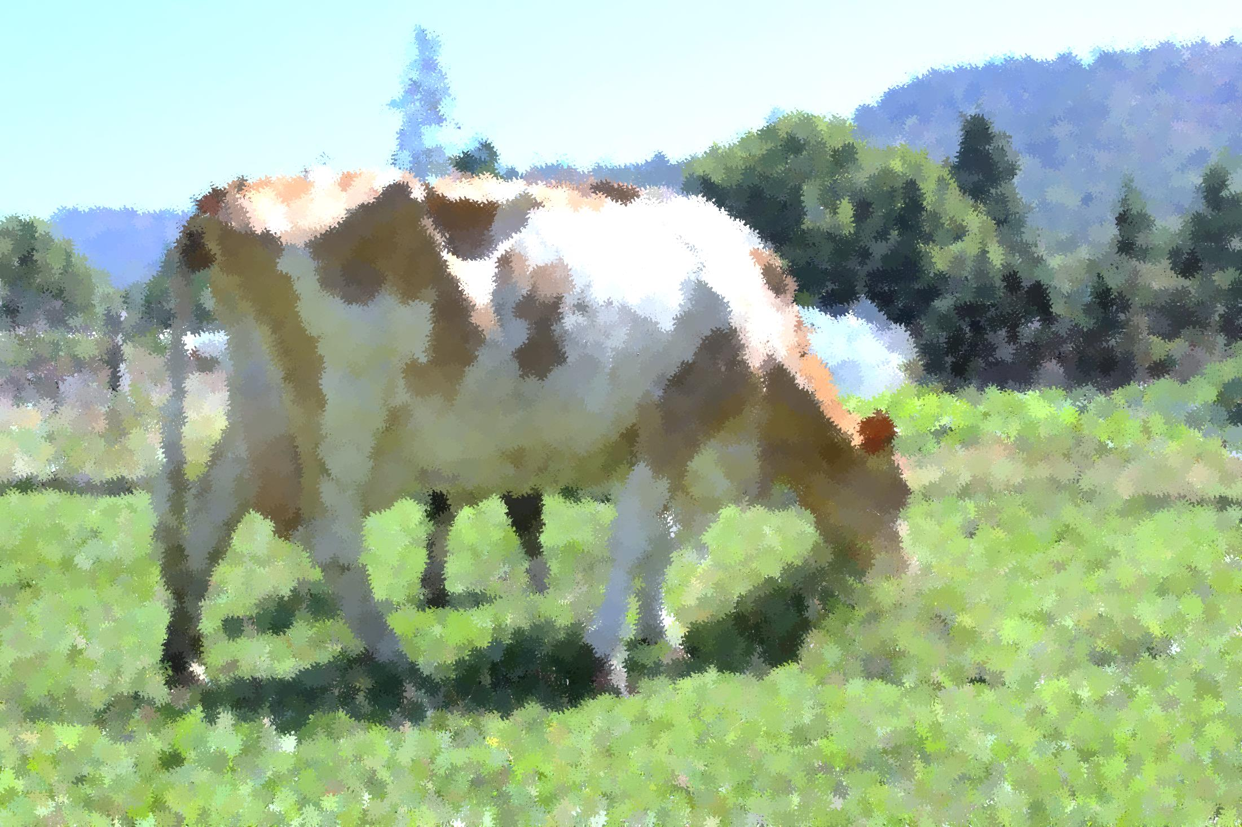
The Story of Milk Revered, Repurposed, Repackaged
Gianaclis Caldwell

Slide 2
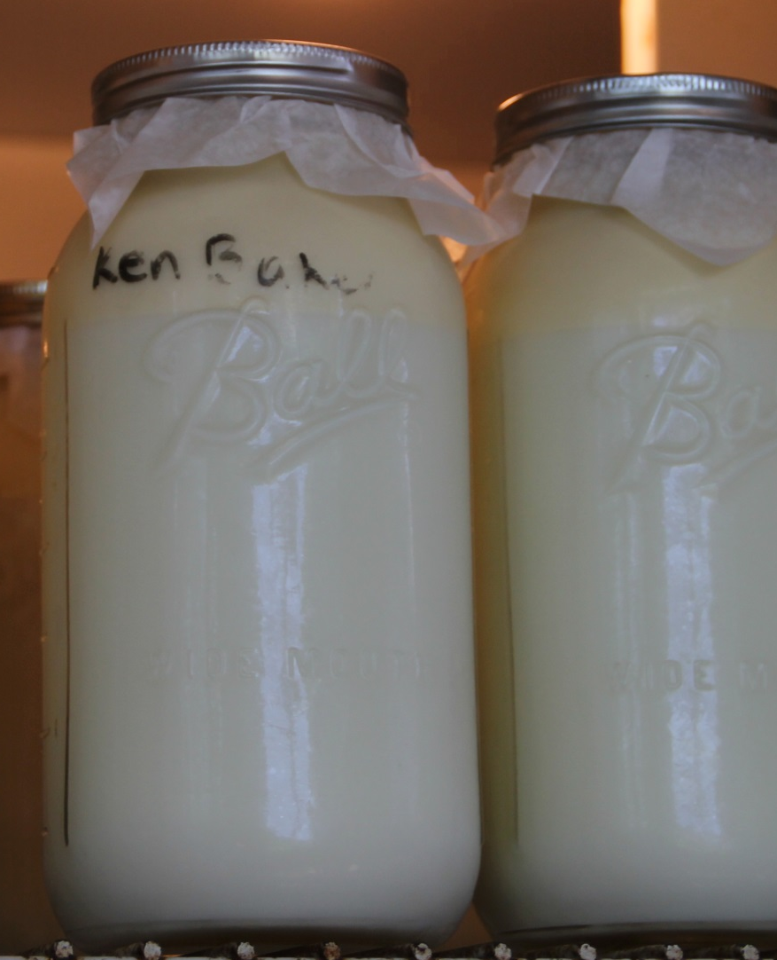
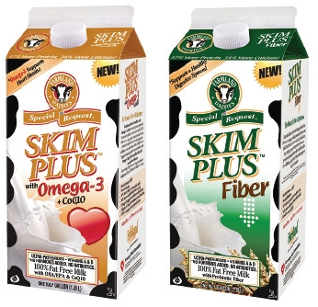
Milk’s 12,000 Year Journey from:

Slide 3
Today’s Food System Paradigm
Safety First
Profit over Provenance
Science and Marketing
The Modern Food System

Slide 4
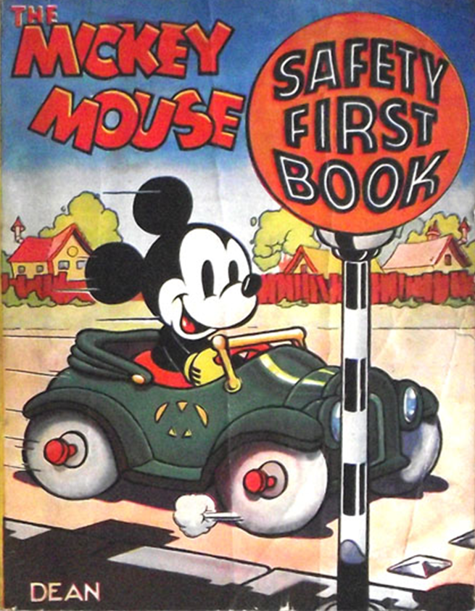
The Modern Food System Paradigm
Safety First Mentality
Antibiotics, antibacterials and antiseptics
Playgounds, tools
Increasing regulatory oversight
Where it is leading:
CDC “we are entering a post-antibiotic era”
21,000 deaths last year
Increase in autoimmune diseases

Slide 5
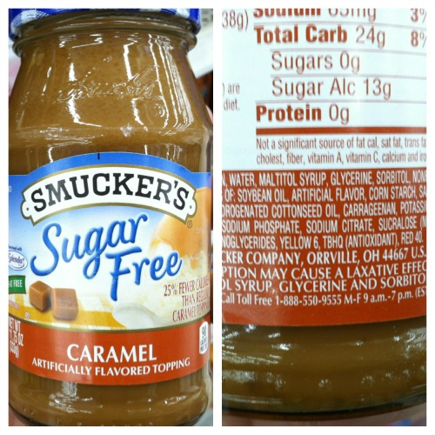
Today’s Food System Paradigm
Profit over Provenance
High caloric, shelf-stable, high profit margin products
Competition increases search for cheaper ingredients
Science and Marketing
Science and “study based” nutrition guidelines vs common sense and traditional foods

Slide 6
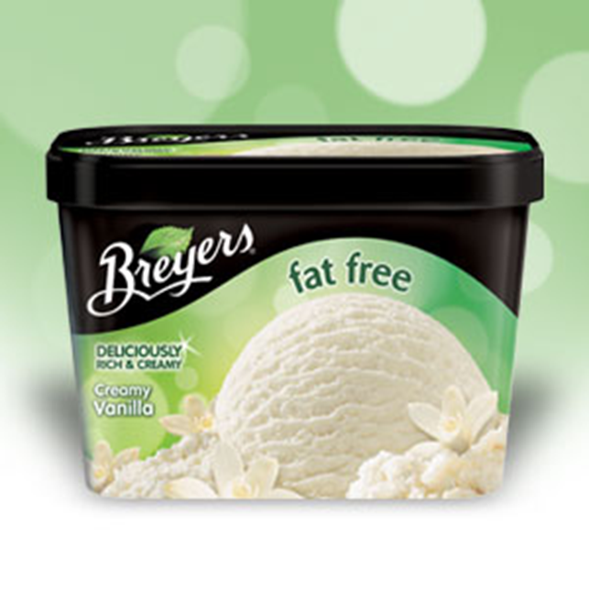
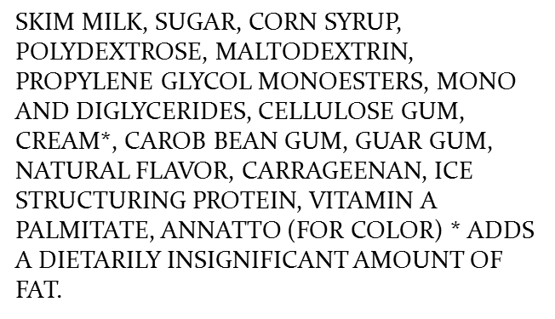
Today’s Food System Paradigm
Profit over Provenance
High caloric, shelf-stable, high profit margin products
Competition increases search for cheaper ingredients
Science and Marketing
Science and “study based” nutrition guidelines vs common sense and traditional foods

Slide 7
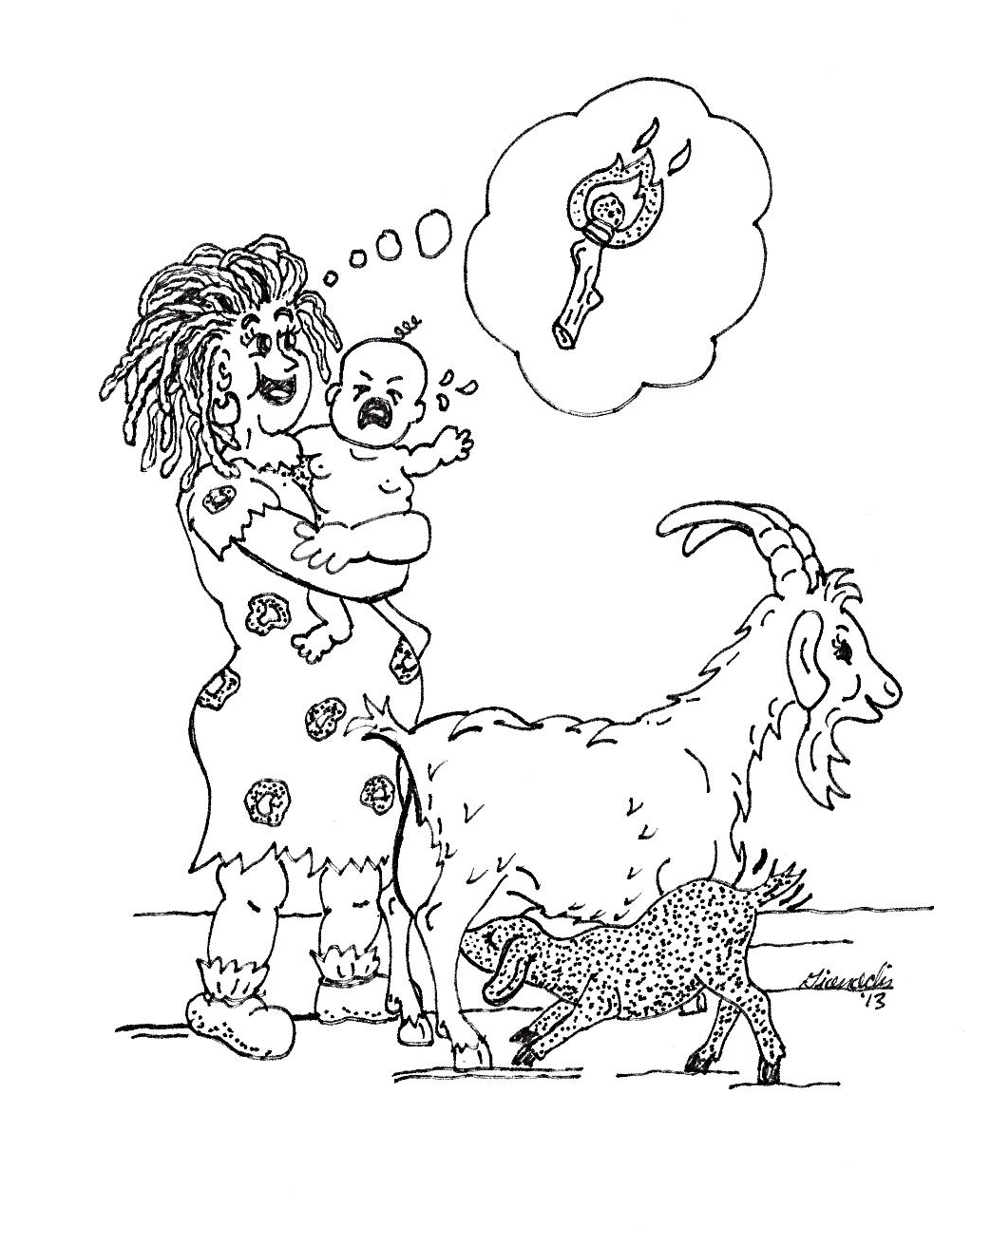
In the Beginning…
Neolithic epiphany
Lactase persistence and Vitamin D
Fermented to Fresh

Slide 8
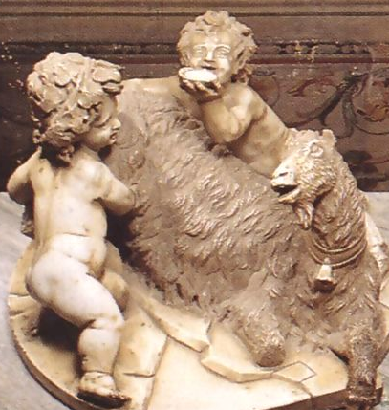
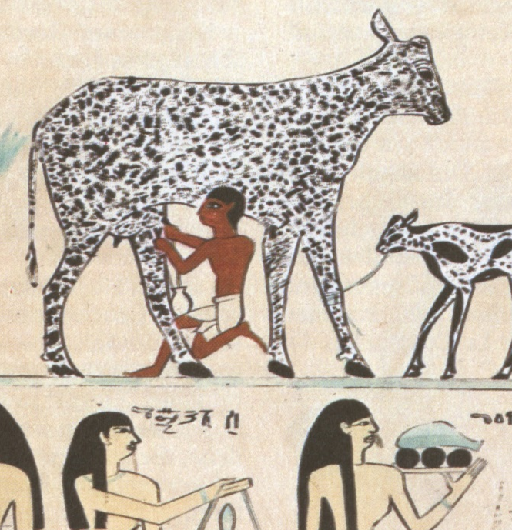
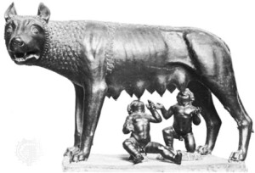
Milk through the Middle Ages
Greek Mythology
Early Rome
Egypt and elsewhere
Nomadic Tribes
European Class system, milk as “Peasant Food”

Slide 9

Milk Becomes a Mainstay
Galenic principles
Italian Renaissance 1465 “The Right Pleasures of Good Health”
End of 16th century – food anxiety
Peasant food
English mainstay
White meat

Slide 10
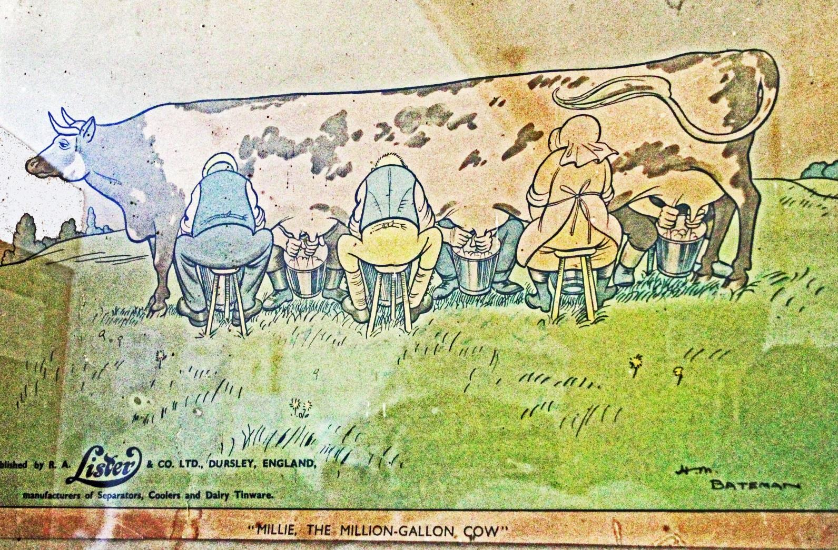
The Beginnings of the Industrial Dairy
Urban Growth
Milk popularity
The Dutch Paradox
Pasture management and fertility
productive cow
Urban demand

Slide 11
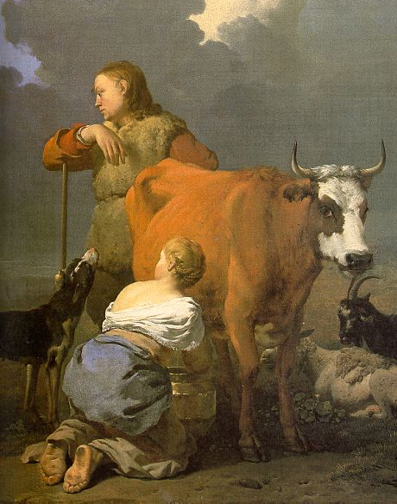
Milk in North America
Protestant influence
“nourished without indulgence”
Family cow = independence and health
Growth of cities
The Oleo effect
Ice and rail

Slide 12
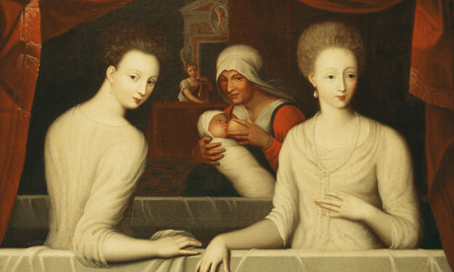
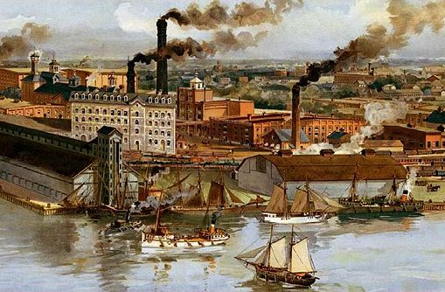
The Perfect Storm
The wet nurse paradox
Urban poor
Alcohol and milk
Sanitation and disease
Dilution and tainting
Infant mortality

Slide 13
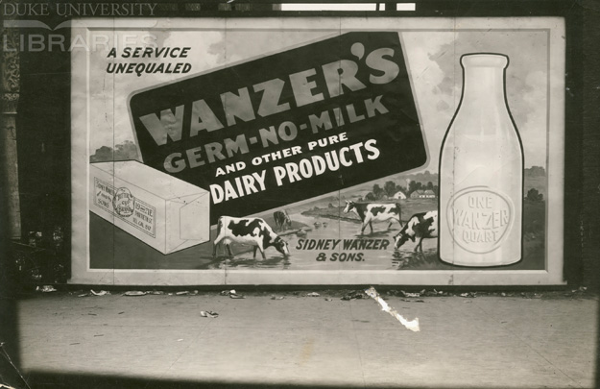
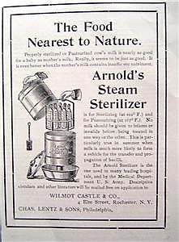
Reform
The Certified Dairy
Chemical “sanitation”
Pasteurization
The birth of the regulatory juggernaut

Slide 14
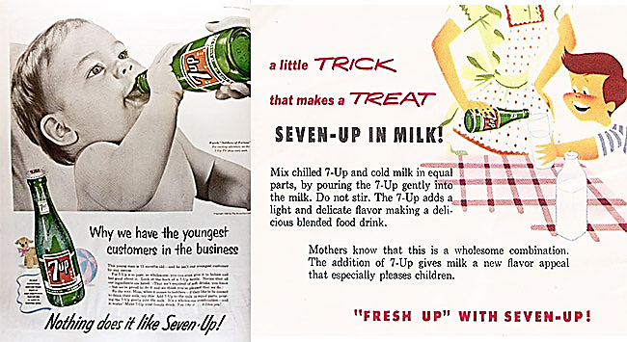
Milk 2.2
Studies Show…
The Rise of Soda and the Sweet Revolution
Fighting for market shares
Flavors, vitamins, fads
Production Paradox
Overly productive cows and rBST
Milk pricing
Fear of Food and the Numbing of Taste

Slide 15
Nurturing a New Paradigm
Food Rights
Historical Perspective
Dynamics of research science
Lifestyle choice rights
Risk Acceptance Spectrum
Choices through knowledge
Support of local markets and small producers

Slide 16
Common Sense Criteria for Food Choices – Applied to Milk
If an ingredient or process is used to :
Replace a more expensive ingredient or process
e.g. pasteurization instead of holistic animal management and careful collection
Replace a nutrient that was removed by processing
e.g.Vitamin D
Add a nutrient/ingredient not naturally present
e.g. Fiber, fish oil
Make the process cheaper and easier
e. g. feeding practices, genetics
Increase shelf life and stability
UHT milk, thickeners
Boost flavor, eye appeal, convenience
Homogenization, flavoring
Then Question It!

Slide 17
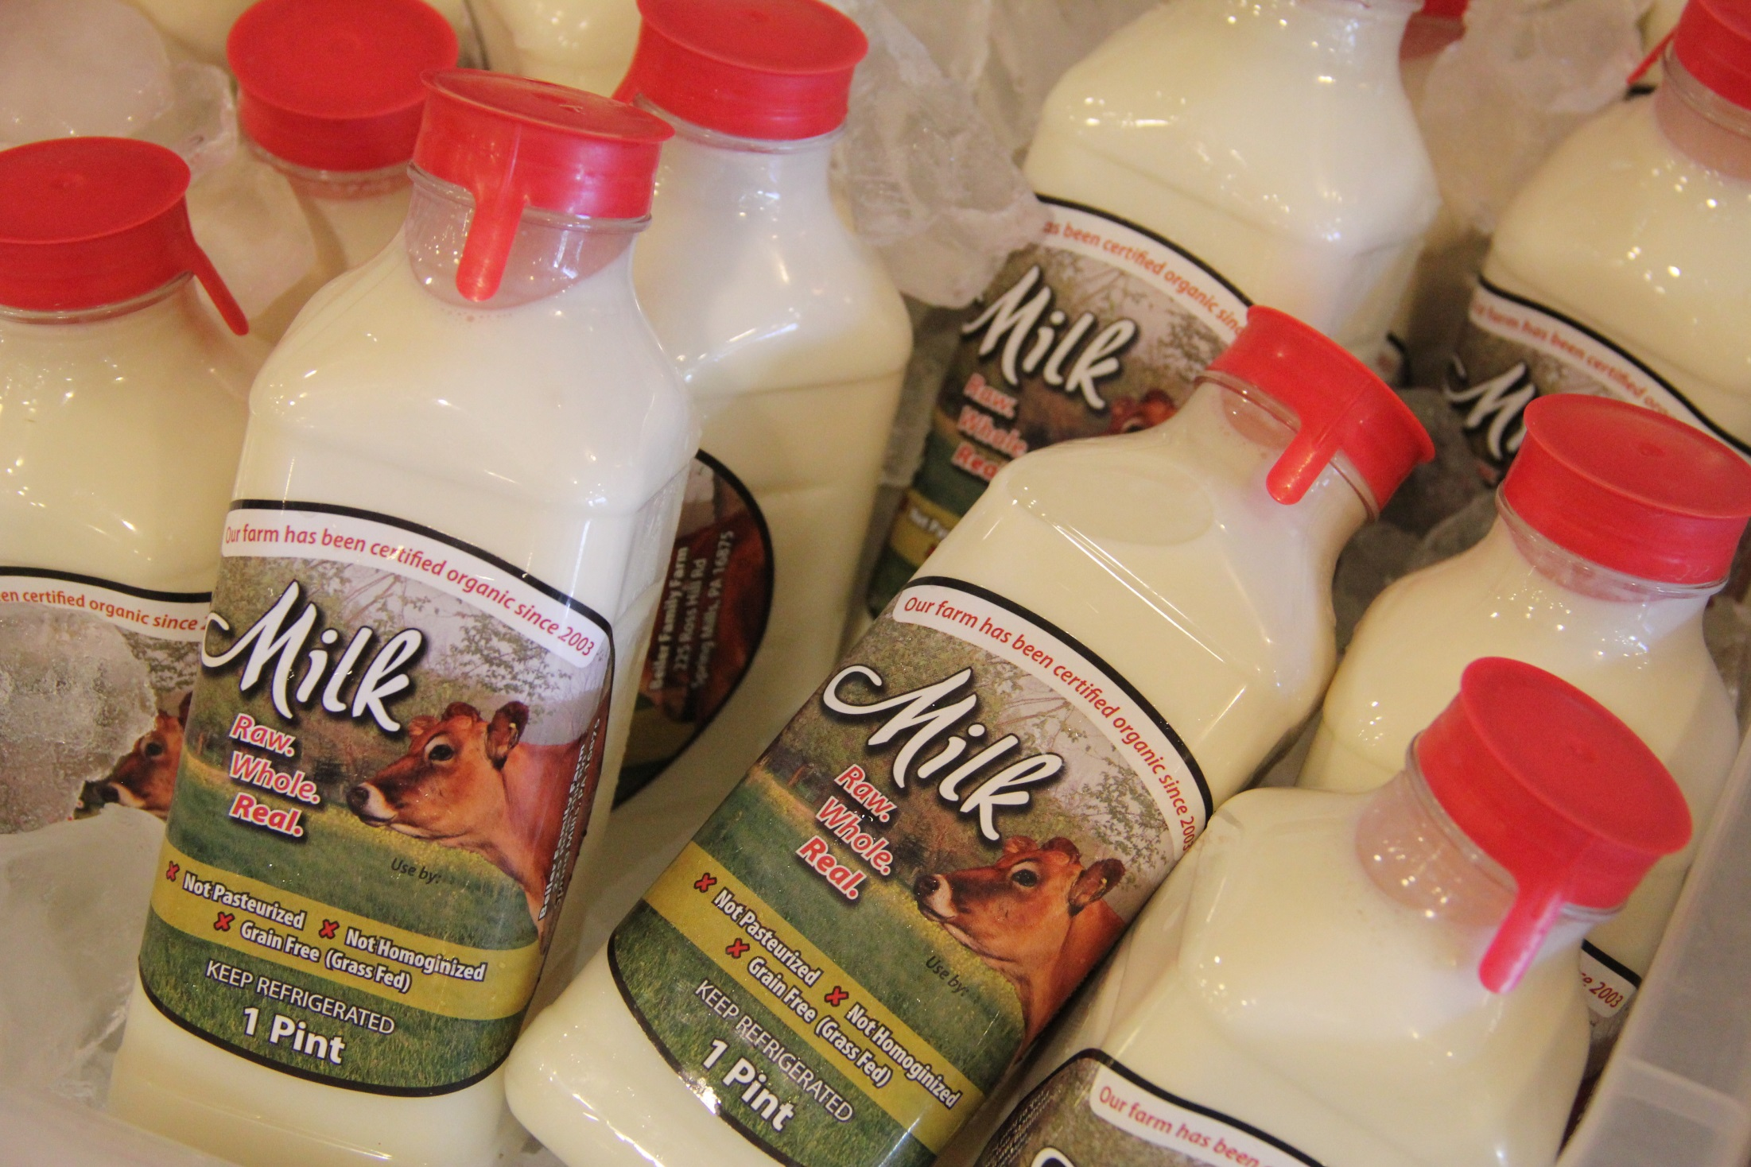
Wise Traditions !

Slide 18
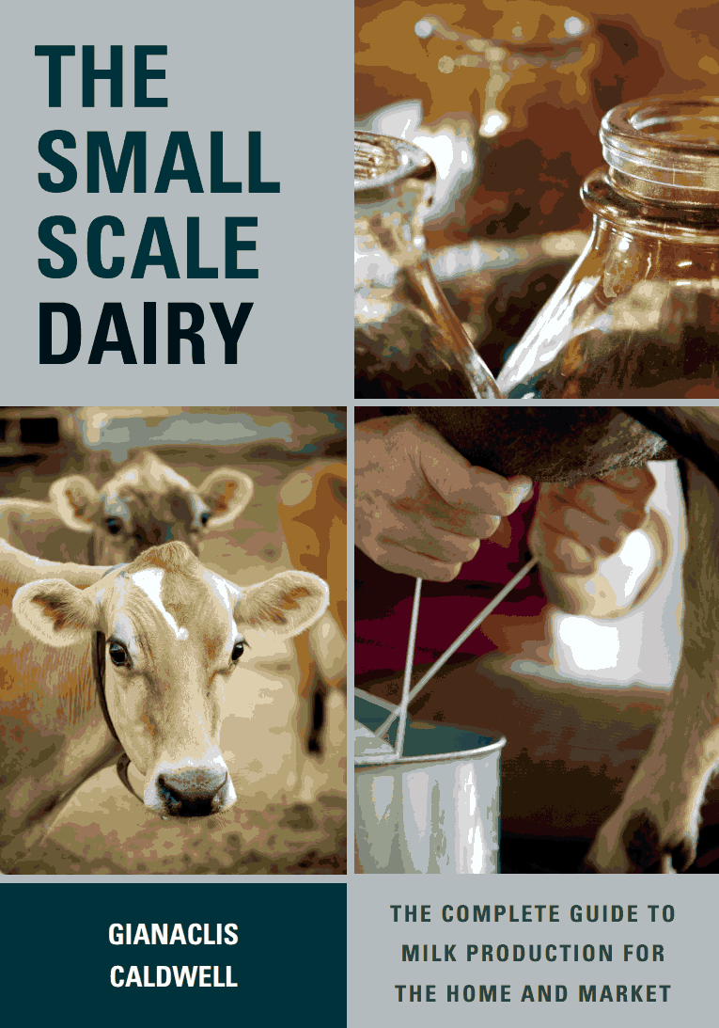
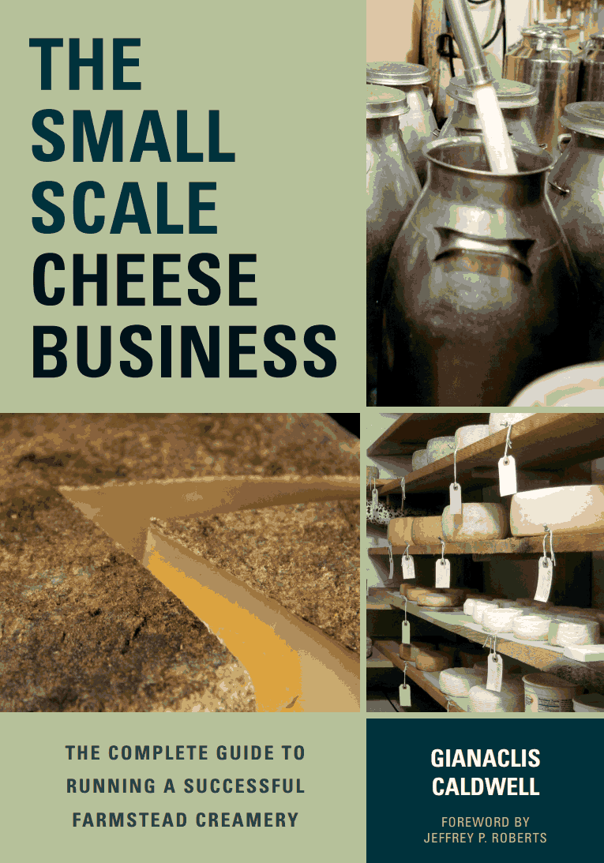
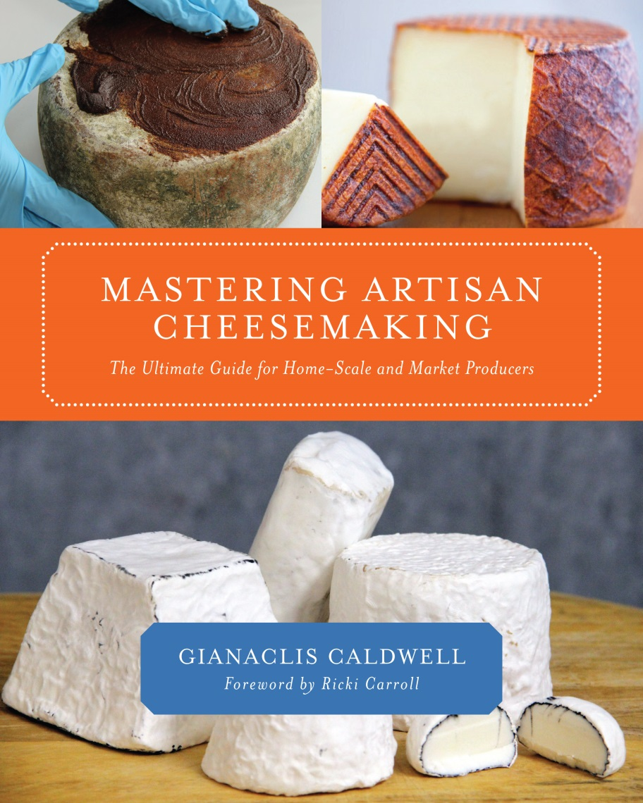

Slide 19
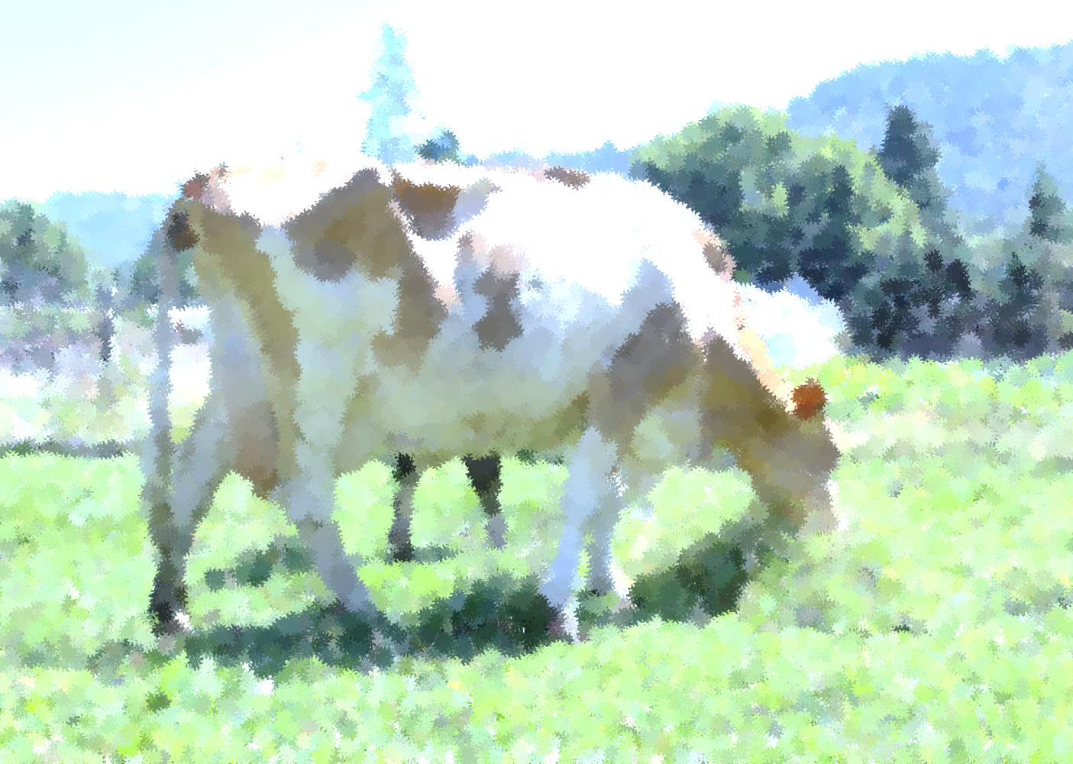
Read More
Milk, a Local and Global History, Deborah Valenze
Milk, The Surprising Story of Milk Through the Ages, Anne Mendelson
Life, Liberty, and the Pursuit of Food Rights: The Escalating Battle over Who Decides What We Eat, David Gumpert
The Untold Story of Milk, Ron Schmidt

