Slide 1

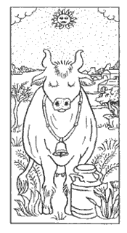
A Campaign for
FULL-FAT
PASTURE-FED
UNPROCESSED
By the Weston A. Price Foundation
A Campaign for Real Milk Is a Project of The Weston A. Price Foundation
westonaprice.org
This document is posted at realmilk.com.
Updated September, 2011

Slide 2
Presentation Topics
Is Real Milk Safe?
Is Real Milk More Nutritious?
Is Milk from Pastured Cows More Nutritious?
Is Real Milk Better for Farmers?
ACKNOWLEDGEMENTS
With thanks to the following for help in preparing this presentation:
Lee Dexter, President, White Egret Farms
Ron Hull, PhD
Jill Nienhiser
Chris Masterjohn
Ted Beals, MD
Notes:
Presenter’s Note: These are the three main sections of the presentation. Each section will begin with a quote from someone outside the raw milk movement that answers the question in the negative, and then follows with a slide that answers the question in the affirmative. Following that are many slides demonstrating the proof of this assertion.
Speaking Points:

Slide 3
Part 1: Is Raw Milk Safe?
“Drinking raw milk or eating raw milk products is like playing Russian roulette with your health.”
—John F. Sheehan, Director, US Food and Drug Administration, Division of Dairy and Egg Safety
FDA Consumer, Sept/Oct 2004.
Notes:
Speaking Points: When John Sheehan said this, he was talking about bulk raw milk at factories, where pathogens are commonly found in the raw milk. This is because the milk has come from tens of farms some of which have poor hygiene standards, operate with dirty equipment and milk sick cows. In addition, polluted farm water may be inter-mixed with the milk at bulk-truck collection off farm. Then there are many sources of contamination of the milk at the factory. As we will see, milk destined for pasteurization is allowed to have higher levels of contamination both before and after pasteurization, than milk destined to be drunk raw. The key is that individual farms selling raw milk from grass-fed cows are not allowed to operate with contaminated conditions like these. Raw milk from farms following standards set for raw milk is safe to drink; in fact, is one of the safest foods as shown by the CDC’s data on foodborne illness.
Full Citations:
Bren, Linda, “Got Milk? Make Sure It's Pasteurized,” FDA Consumer, SEP-OCT 2004, available from http://findarticles.com/p/articles/mi_m1370/is_5_38/ai_n6198587, accessed 23 May 2007.

Slide 4
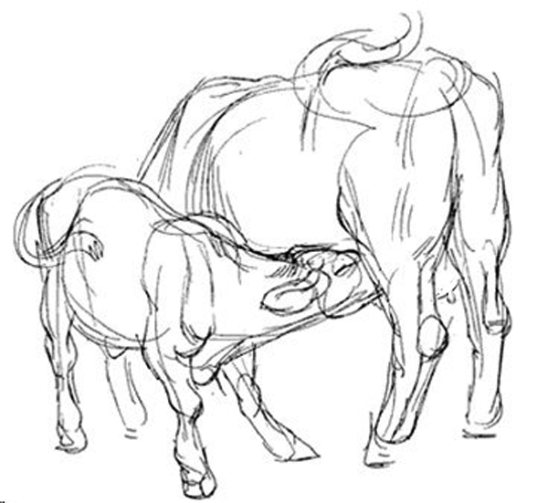
Raw Milk Is Uniquely Safe
Consider the calf, born in a muddy pasture, which then suckles on its mother’s often manure-covered teat. How can that calf, or any mammal survive?
Because raw milk contains multiple, natural, redundant systems of bioactive components that can reduce or eliminate populations of pathogenic bacteria.
Notes:
Speaking Points:

Slide 5
Built-In Protective Systems in Raw Milk: Lactoperoxidase
Uses small amounts of H₂O₂ and free radicals to seek out and destroy bad bacteria¹
Found in all mammalian secretions—breast milk, tears, saliva, etc.^{1,2}
Levels are 10 times higher in goat milk than in breast milk³
Other countries are looking into using lactoperoxidase instead of pasteurization to ensure safety of commercial milk as well as for preserving other foods^{1,2,4,5}
1. Indian J Exp Biology, 1998;36: 808-810.
2. British J Nutrition, 2000;84(Suppl. 1.): S19-S25.
3. J Dairy Sci, 1991;74:783-787.
4. Life Sciences, 2000;66(25):2433-2439.
5. Trends in Food Science & Technology 16 (2005) 137-154
Notes:
Speaking Points:
Full Citations:
1. Jacob, Benoy; Manoj, N.K.; et al, “Antibacterial property of goat milk lactoperoxidase,” Indian Journal of Experimental Biology, August 1998;36:808-810.
2. Kussendrager, Klaas; Van Hooijdonk, A.C.M., “Lactoperoxidase: physico-chemical properties, occurrence, mechanism of action and applications,” British Journal of Nutrition, 2000; 84(Supp 1):S19-S25.
3. Zapico, P.; Gaya, P; et al, “Influence of breed, animal, and days of lactation on lactoperoxidase system components in goat milk,” Journal of Dairy Science, 1991; 74:783.
4. Jacob, Benoy; Antony, Essy; et al, “Thiocyanate mediated antifungal and antibacterial property of goat milk lactoperoxidase,” Life Sciences, 2000; 66(25):2433.

Slide 6
Built-In Protective Systems in Raw Milk: Lactoferrin
Plentiful in raw milk; effectiveness greatly reduced by pasteurization¹
Steals iron away from pathogens and carries it through the gut wall into the blood stream; has anti-inflammatory properties; stimulates the immune system¹
Kills wide range of pathogens including viruses; does not kill beneficial bacteria.²
In a study involving mice bred to be susceptible to tuberculosis, treatment with lactoferrin significantly reduced the burden of tuberculosis organisms.³
Mice injected with Candida albicans, another iron-loving organism, had increased survival time when treated with lactoferrin.⁴
Believed to cut visceral fat levels by as much as 40%.⁵ Many other health benefits—is sold as a supplement!
FDA approved for use in anti-microbial spray to combat E. coli O157:H7 contamination in meat industry!⁶
1. British J Nutrition, 2000;84(Suppl. 1):S11-S17; JACN 2001 20(5):389S-395S.
2. Zimecki and Kruzel. J Exp Ther Oncol. 2007;6(2):89-106; International Dairy Journal 2006 16:1252-1261
3. J Experimental Med, 2002 DEC 02;196(11):1507-1513.
4. Infection and Immunity, 2001 JUN;69(6):3883-3890.
5. MSN-Mainichi Daily News, 2007 APR 11.
6. FDA News, August 22, 2004
Notes:
Speaking Points:
Full Citations:
1. Steijns, Jan; Van Hooijdonk, A.C.M., “Occurrence, structure, biochemical properties and technological characteristics of lactoferrin,” British Journal of Nutrition, 2000;84(Supp 1):S11-S17.
2. Schaible, Ulrich E.; Colins, Helen L.; et al, “Correction of the Iron Overload Defect in B-2-Microglobulin Knockout Mice by Lactoferrin Abolishes Their Increased Susceptibility to Tuberculosis,” Journal of Experimental Medicine, 2002 DEC 02, 196(11):1507-1513.
3. Tanida, Toyohiro; Rao, Fu; et al, “Lactoferrin peptide increases the survival of Candida albicans-innoculated mice by upregulating neutrophil and macrophage functions, especially in combination with Amphotericin B and granulocyte-macrophage colony-stimulating factor,” Infection and Immunity, 2001 JUN; 69(6):3883-3890.
4. Connell, Ryan, “Boom or bust: Breast milk ballyhooed to beat the bulge,” MSN-Mainichi Daily News, 2007 APR 11, available from http://mdn.mainichi-msn.co.jp/waiwai/news/20070411p2g00m0dm002000c.html, accessed 2007 MAY 26.

Slide 7
Built-In Protective Systems in Raw Milk: Other Bioactive Components I – Components of Blood
Leukocytes—Eat all foreign bacteria, yeast and molds (phagocytosis). Destroyed at 56C and by pumping milk. Produce H₂O₂ to activate the lacto-peroxidase system. Produce anaerobic CO₂ that blocks all aerobic microbes. Basis of immunity.
B-lymphocytes – Kill foreign bacteria; call in other parts of the immune system^{1,2}
Macrophages – Engulf foreign proteins and bacteria²
Neutrophils – Kill infected cells; mobilize other parts of the immune system¹
T-lymphocytes – Multiply if bad bacteria are present; produce immune-strengthening compounds¹
Immunoglobulins (IgM, IgA, IgG1, IgG2)--Transfer of immunity from cow to calf/person in milk and especially colostrum; provides “passive immunization”²
Antibodies—Bind to foreign microbes and prevent them from migrating outside the gut; initiate immune response.
Scientific American, December 1995.
2. British J of Nutrition, 2000:84(Suppl. 1):S3-S10, S75-S80, S81-S89, S135-136.
Notes:
Speaking Points:
Full Citations:

Slide 8
Built-In Protective Systems in Raw Milk: Other Bioactive Components II – Fats and Carbohydrates
Polysaccharides—Encourage the growth of good bacteria in the gut; protect the gut wall
Oligosaccharides – Protect other components from being destroyed by stomach acids and enzymes; bind to bacteria and prevent them from attaching to the gut lining; other functions just being discovered.^{1,2}
Medium-Chain Fatty Acids—Disrupt cell walls of bad bacteria; levels so high in goat milk that the test for the presence of antibiotics had to be changed; may reduce intestinal injury and protect the liver.³
Phospholipids and Spingolipids—bind to intestinal cells, prevent absorption of pathogens and toxins.³ Spingolipids are important components in cell membranes, protect cells against toxins, support digestion and protect against cancer.
1. British J Nutrition, 2000:84(Suppl. 1):S3-S10.
2. Scientific American, December 1995.
International Dairy Journal 2006 16:1374-1382 and 1362-1373
Spingolipids and Cancer, scitopics.com; Koopman, J S, et al, AJPH, 1984, 74:12:1371-1373
Notes:
Speaking Points:
Full Citations:
1. Newman, Jack, “How Breast Milk Protects Newborns,” Scientific American, December 1995, page 76.
2. Shah, Nagendra P., “Effects of milk-derived bioactives: an overview,” British Journal of Nutrition, 2000;84(Supp 1):S3-S10.
3. Korhonen, Hannu; Marnila, P.; et al, “Milk immunoglobulins and complement factors,” British Journal of Nutrition, 2000;84(Supp 1):S75-S80.
4. Cross, Martin L.; Gill, H.S., “Immunomodulatory properties of milk,” British Journal of Nutrition, 2000;84(Suppl 1):S81-S89.

Slide 9
Built-In Protective Systems in Raw Milk: Other Bioactive Components III
Enzymes, e.g. Complement & Lysozyme—Disrupt bacterial cell walls. Complement destroyed at 56C; Lysozyme at 90C.^{1,2}
Hormones & Growth Factors – Stimulate maturation of gut cells; prevent “leaky” gut.²
Mucins – Adhere to bacteria and viruses, preventing those organisms from attaching to the mucosa and causing disease.^{1,2}
Fibronectin – Increases anti-microbial activity of macrophages and helps to repair damaged tissues.¹
Glycomacropeptide – Inhibits bacterial/viral adhesion, suppresses gastric secretion, and promotes bifido-bacterial growth; supports immune system. ³
1. British J Nutrition, 2000:84(Suppl. 1):S3-S10.
2. Scientific American, December 1995.
3. British J Nutrition, 2000:84(Suppl. 1):S3-S10, S39-S46
Notes:
Speaking Points:
Full Citations:
1. Shah, Nagendra P., “Effects of milk-derived bioactives: an overview,” British Journal of Nutrition, 2000;84(Supp 1):S3-S10.
2. Newman, Jack, “How Breast Milk Protects Newborns,” Scientific American, December 1995, page 76.

Slide 10
Built-In Protective Systems in Raw Milk: Other Bioactive Components IV
Beneficial Bacteria – Lactobacilli and bifidus bacteria, crowd out bad bacteria, product lactic acid that kills bad bacteria.
Bifidus Factor – Promotes growth of Lactobacillus bifidus, a helpful bacteria in baby’s gut, which helps crowd out dangerous germs^{1,2}
B₁₂ Binding Protein – Reduces Vitamin B₁₂ in the colon, which harmful bacteria need for growth¹
Lactoglobulins: Carry vitamins A and D and possibly other nutrients.³
1. Scientific American, December 1995.
2., British J Nutrition, 2000:84(Suppl. 1):S3-S10, S39-S46.
3. FEBS Journal 2009 276:2251-2265.
Notes:
Speaking Points:
Full Citations:
Newman, Jack, “How Breast Milk Protects Newborns,” Scientific American, December 1995, page 76.
Shah, Nagendra P., “Effects of milk-derived bioactives: an overview,” British Journal of Nutrition, 2000;84(Supp 1):S3-S10.
Brody, Ernest P., “Biological activities of bovine glycomacropeptide,” British Journal of Nutrition, 2000;84(Suppl 1):S39-S46.

Slide 11
Fivefold Protective System in Raw Milk
Destroys pathogens in the milk.
Stimulates the Immune system.
Builds healthy gut wall.
Prevents absorption of pathogens and toxins in the gut.
Ensures assimilation of all the nutrients.

Slide 12
Destruction of Built-In Safety Systems by Pasteurization
1. Scientific American, December 1995.
2. The Lancet, 17 NOV 1984;2(8412):1111-1113.
Component | Breast Milk | Raw Milk | Pasteurized Milk | UHT Milk | Infant Formula
B-lymphocytes Macrophages Neutrophils Lymphocytes IgA/IgG Antibodies B₁₂ Binding Protein Bifidus Factor Medium-Chain Fatty Acids Fibronectin Gamma-Interferon Lactoferrin Lactoperoxidase Lysozyme Mucin A/Oligosaccharides Hormones & Growth Factors | active active active active active active active active active active active active active active active | active active active active active active active active active active active active active active active | inactivated inactivated inactivated inactivated inactivated inactivated inactivated reduced inactivated inactivated reduced reduced reduced reduced reduced | inactivated inactivated inactivated inactivated inactivated inactivated inactivated reduced inactivated inactivated inactivated inactivated Inactivated reduced reduced | inactivated inactivated inactivated inactivated inactivated inactivated inactivated reduced inactivated inactivated inactivated inactivated inactivated inactivated Inactivated
Notes:
Speaking Points: This is a very important slide. We have listed all the known protective components in milk and show that they are mostly inactivated by pasteurization. Pasteurization destroys milk’s amazing built-in safety system.
Full Citations:
1. Newman, Jack, “How Breast Milk Protects Newborns,” Scientific American, December 1995, page 76.
2. Narayanan, Indira; Murthy, N.S.; et al, “Randomised controlled trial of effect of raw and holder pasteurised human milk and of formula supplements on incidence of neonatal infection,” The Lancet, 17 NOV 1984;2(8412):1111-1113.

Slide 13
Destruction of Built-In Safety Systems by Pasteurization II
Milk’s anti-microbial properties have been detailed only recently, but the destruction of protective properties was recognized as early as 1938 in studies showing that raw milk did not support the growth of a wide range of pathogens.
Researchers noted that heating milk supports the growth of harmful bacteria by inactivating “inhibins” (factors that inhibit bacterial growth).
The Drug and Cosmetic Industry, 1938:43:1.
Notes:
Speaking Points:
Full Citations:
Dold, H.; Wizaman, E.; et al, “Antiseptic in Milk,” The Drug & Cosmetic Industry, July 1938;43(1).

Slide 14
What is Pasteurization?
PASTEURIZATION is a process that slows microbial growth in food.
NOT INTENDED TO KILL ALL PATHOGENS: Pasteurization is not intended to kill all pathogenic micro-organisms in the food or liquid, but aims to reduce the number of viable pathogens so they are unlikely to cause disease.
TWO MAIN TYPES of pasteurization used today:
1. High Temperature/Short Time (HTST): 161º F for 15-20 seconds
2. Ultra-Heat Treated (UHT): 280º F for fraction of second
RAPID HEATING: Both treatments involve rapid heating by forcing the milk between super heated stainless steel plates.
http://en.wikipedia.org/wiki/Pasteurization

Slide 15
Coliforms – not the same as pathogens
Rod-shaped bacteria found everywhere in the environment, including the gut, the feces, soil, water and plants.
Four main groups: E.coli, Kiebsiella, Enterobacter, Citrobacter.
Key characteristic: ferment lactose into lactic-acid.
“. . . Research results have shown that total coliforms may not be an appropriate bacterial indicator of fecal pollution.”
“. . . Significant concentrations of coliforms in distribution systems do not represent a health risk to water consumers.”
“With few exceptions, coliforms themselves are not considered to be a health risk. . .”
“It is widely accepted that the total coliform group of bacteria is diverse and they can be considered normal inhabitants of many soil and water environments that have not been impacted by fecal pollution.”
Stevens and others. Review of Coliforms, Australian Government, 10-11 April 2003

Slide 16
Coliforms in raw milk inhibit pathogen growth
Enterococci (considered “virulent” and/or “antibiotic resistant” in hospitals) inhibit pathogens such as Listeria in raw feta cheese. eurekalert.org, April, 2008.
Lactobicillus and staphylococus produce bacteriocins against L. Monocytogenes and are sold as commercial starters to control listeria. Hull. Australian Journal of Dairy Technology Aug 2007;62(2):100-102
Staphylococci, Streptococci, Lactobacillis and Ent. faecalis in raw human milk inhibit pathogenic Staph aureus. Heikkila and Saris. J Appl Microbiology 2003,95, 471-478

Slide 17
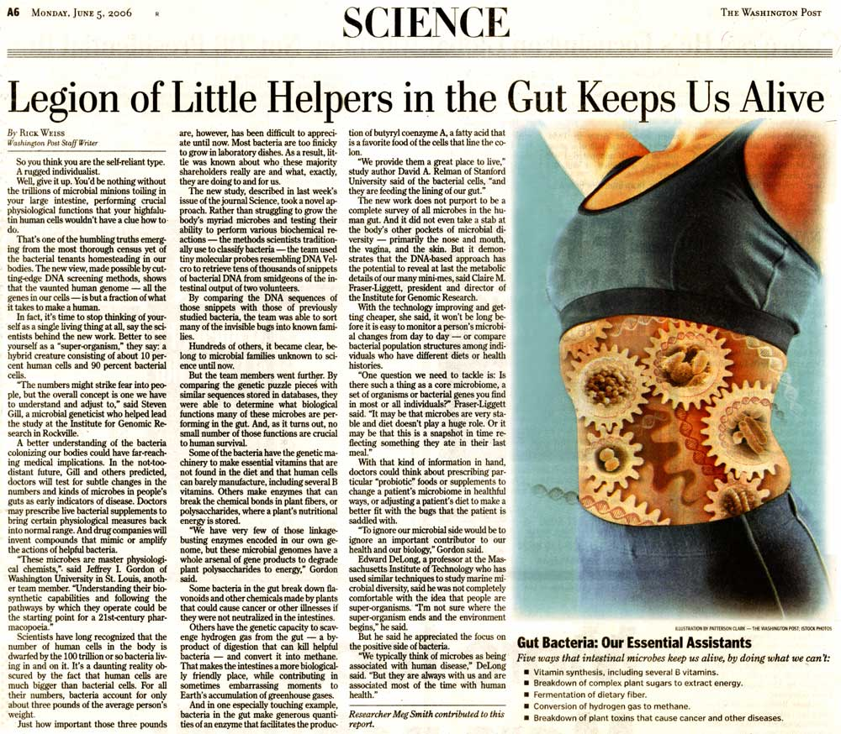
New Medical Paradigm- Coliforms Essential
OLD PARADIGM: Healthy human body is sterile and microbes attack it, making us sick.
NEW PARADIGM: Healthy human body lives in symbiotic relationship with microorganisms.
Arguments for pasteurization are based on a discredited medical paradigm.

Slide 18
Medical Uses of Coliform Bacteria
Reseeding of colon with fecal bacteria to combat diarrhea from overgrowth of Clostridium difficile after antibiotic treatment.
Lactobacillis to combat rotaviruses that cause diarrhea and intestinal inflammation in children.
Streptococcus nasal spray to combat pathogens that cause otitis media (ear infections).
Lactobacillis to prevent Staph. aureus from colonizing wound sites.
A harmless strain of E. Coli injected into the bladder to successfully combat urinary tract infections.
Science News Online, February 2, 2002; Vol 161, No. 5.

Slide 19
Food-Borne Illnesses Associated with Milk
A Comparison with Other Foods, 1997
Milk, both pasteurized and raw,
has low rate of causing food-borne illness
MMWR Mar 2, 2000:49(SS01);1-51
Food | No. of Outbreaks | % | No. of Cases | %
Milk | 2 | 0.4 | 23 | 0.2
Eggs | 3 | 0.6 | 91 | 0.8
Chicken | 9 | 1.8 | 256 | 2.1
Fruits/Vegetables | 15 | 3.0 | 719 | 6.0
Salads | 21 | 4.2 | 1104 | 9.2
Notes:
Speaking Points: The chief cause of food borne illness is lettuce, then fruits and vegetables, then chicken. Yet, our government does not insist that we pasteurize these foods.
Full Citations:
Centers for Disease Control, “Surveillance for Foodborne-Disease Outbreaks--United States, 1993-1997,” Morbidity and Mortality Weekly Report, March 17, 2000:49(ss01);1-51, Table 21, Page 32. http://www.cdc.gov/mmwR/preview/mmwrhtml/ss4901al.htm.

Slide 20
Food-Borne Illnesses 1990 - 2004
Center for Science in the Public Interest
FOOD | NO. OF OUTBREAKS | % | NO. OF CASES | %
Produce | 639 | 22% | 31,496 | 38%
Poultry | 541 | 18% | 16,280 | 20%
Beef | 467 | 16% | 13,220 | 16%
Eggs | 341 | 11% | 11,027 | 13%
Seafood | 984 | 33% | 9,969 | 12%
Notes:
Speaking Points:
Full Citations:
Centers for Disease Control, “Surveillance for Foodborne-Disease Outbreaks--United States, 1993-1997,” Morbidity and Mortality Weekly Report, March 17, 2000:49(ss01);1-51, Table 21, Page 32. http://www.cdc.gov/mmwR/preview/mmwrhtml/ss4901al.htm.

Slide 21
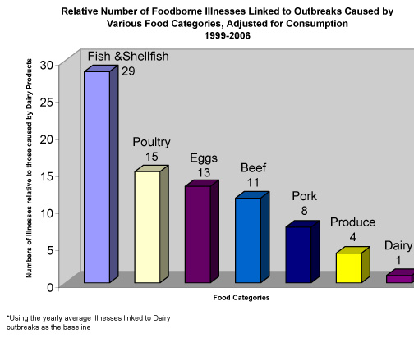
Food-Borne Illness 1999-2006

Slide 22
Campylobacter—Most Common Cause of Food-Borne Illness
While raw milk often gets the blame for food-borne illnesses, Campylobacter is the most common cause and is best known for contaminating meats.
Applied and Environmental Microbiology, 2001:67(12):5431-5436
Meats sampled for Campylobacter from 59 Washington, DC grocery stores during 1999-2000.
 | No. of Samples | % Positive
Chicken | 184 | 70.7%
Turkey | 172 | 14.5%
Pork | 181 | 1.7%
Beef | 182 | 0.5%
Notes:
Speaking Points:
Full Citations:
Zhao, Cuiwei; Ge, Beilei; et al, “Prevalence of Campylobacter spp., Escherichia coli, and Salmonella serovars in retail chicken, turkey, pork, and beef from the greater Washington DC area,” Applied & Environmental Microbiology, December 2001;67(12):5431.

Slide 23
Listeria monocytogenes – Deadly food pathogen
Raw milk is often blamed for causing infection with Listeria Monocytogenes, a deadly food pathogen that can cause severe illness and fetal death, premature birth or neonatal illness and death.
In a 2003 USDA/FDA report: Compared to raw milk
515 times more illnesses from L-mono due to deli meats
29 times more illness from L-mono due to pasteurized milk
On a PER-SERVING BASIS, deli meats were TEN times more likely to cause illness
FDA: “Raw milk is inherently dangerous and should not be consumed.”
Where are the FDA’s charges that deli meats are “inherently dangerous and should not be consumed? Where is the FDA’s exhortation to “everyone charged with protecting the public health” to “prevent the sale of deli meats to consumers”?
Interpretive Summary – Listeria Monocytogenes Risk Assessment,
Center for Food Safety and Applied Nutrition,
FDA, USDHHS, USDA, Sept. 2003, page 17
Notes:
Speaking Points:
Full Citations:
Intrepretive Summary – Listeria Monocytogenes Risk Assessment,
Center for Food Safety and Applied Nutrition,
FDA, USDHHS, USDA, Sept. 2003, page 17

Slide 24
Listeria monocytogenes – Not a Problem in Raw Milk
In a response to a Freedom of Information Act request, the Centers for Disease Control provided data on raw milk outbreaks 1993-2005—a 13-year period.
In this report, CDC listed NO cases of foodborne illness from raw milk caused by Listeria during the period.
Recently the Pennsylvania Department of Agriculture (PDA) has suspended sales of several dairies and issued inflammatory press releases, claiming Listeria monocytogenes in the milk.
Independent tests have shown NO Listeria in the milk and in all cases sales were resumed. There were no illnesses.
Is the PDA trying to falsely build a case that Listeria is a problem in raw milk?
Cdc-foodborne-illness-report-1973-2005.pdf
Notes:
Speaking Points:
Full Citations:
Cdc-foodborne-illness-report-1973-2005.pdf

Slide 25
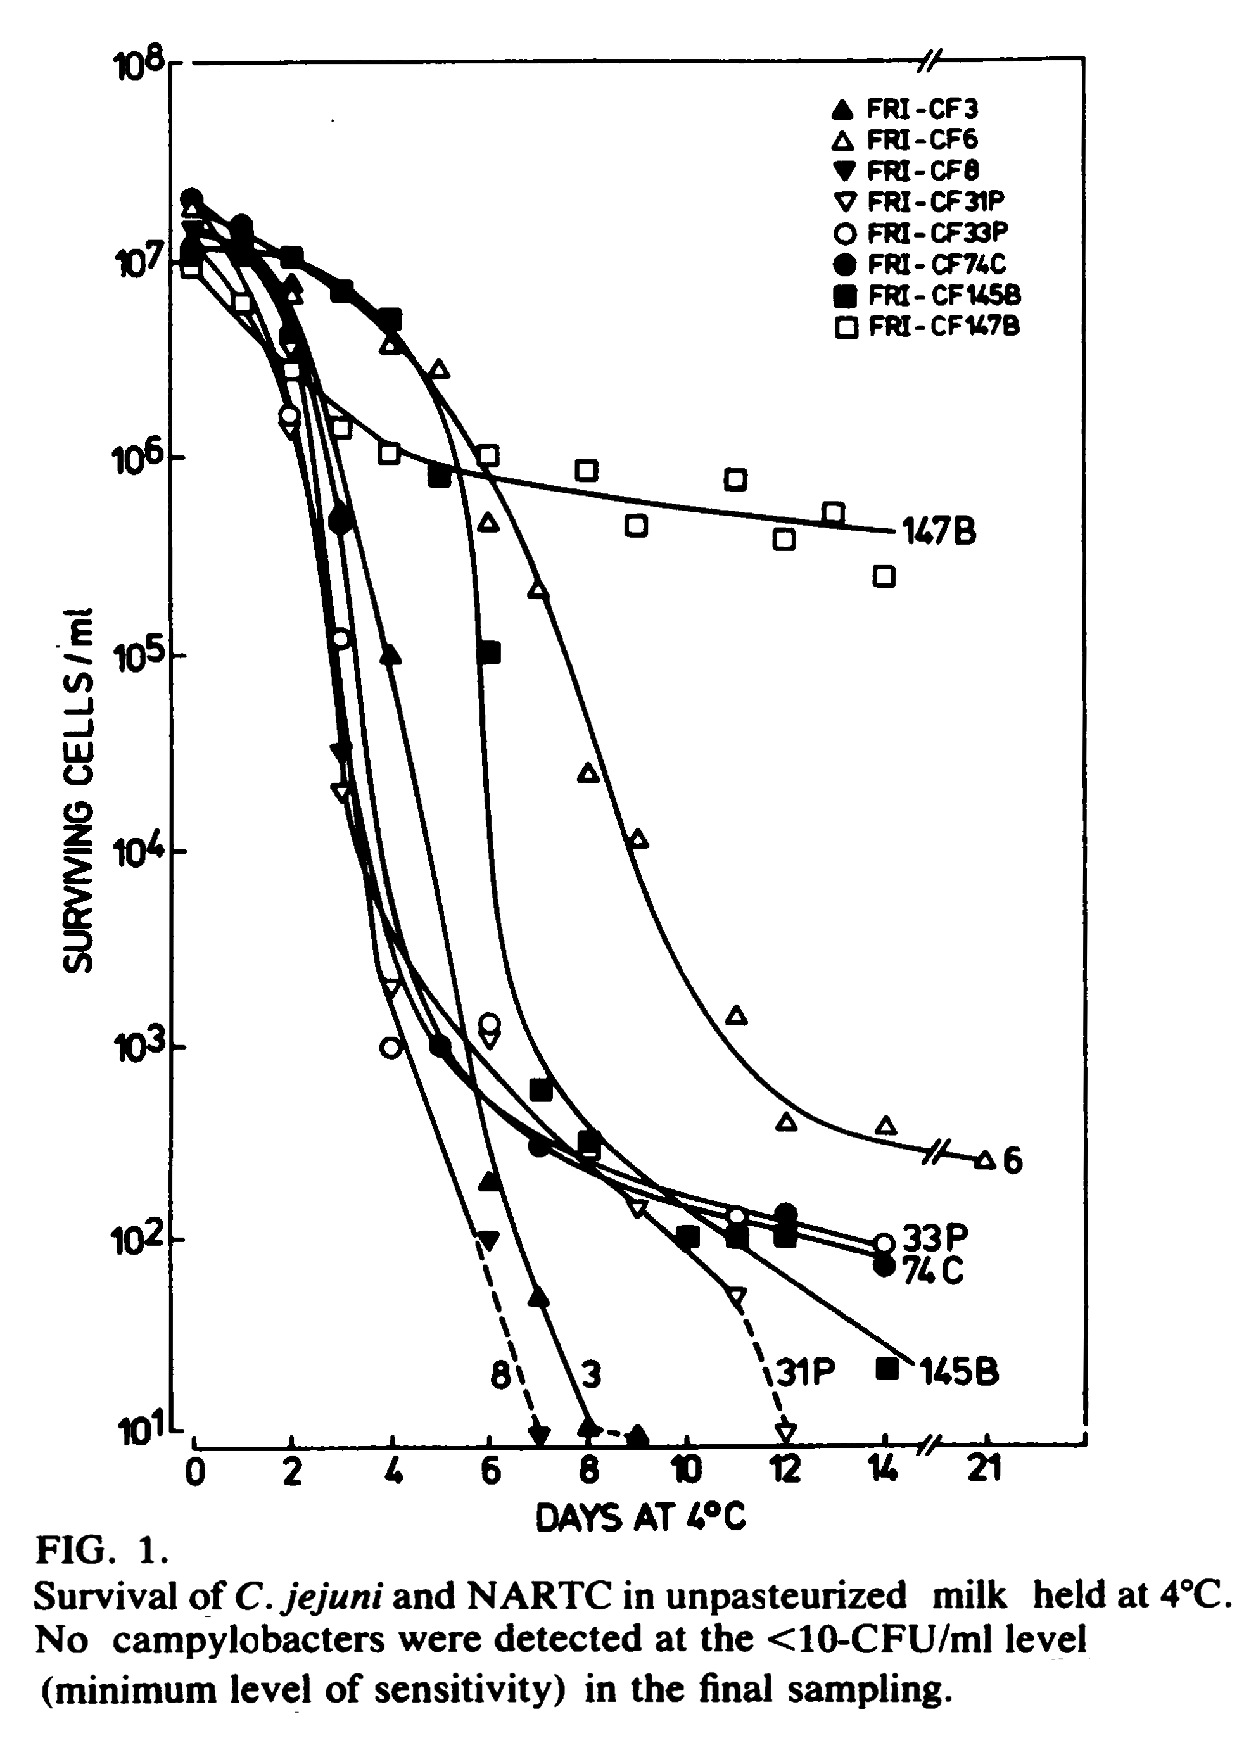
Raw Milk Challenge Tests I
Large amounts of Campylobacter (an amount found in 20,000 grams manure) added to chilled raw milk (4º C):
Most strains showed a dramatic decline
Day 0 = 13,000,000/ml
Day 9 = less than 10/ml
The only stain that did not decline was
a non-human strain.
Applied and Environmental Microbiology,
1982;44(5):1154-58
Notes:
Speaking Points:
Full Citations:
Doyle, Michael; Roman, Debra, “Prevalence and survival of campylobacter jejuni in unpasteurized milk,” Applied & Environmental Microbiology, November, 1982;44(5):1154.
Diker, K. Serdar; Erdeger, Jale; et al, “A Study on the Survival of Campylobacter Coli in Raw Milk,” Mikrobiyoloji Bülteni, 1987;21:200.

Slide 26
Raw Milk Challenge Tests II
Campylobacter in raw milk at body temperature (37º C):
Bovine strains decreased by 100 cells/ml in 48 hrs.
Poultry strains decreased by 10,000 cells/ml in 48 hrs.
The protective components worked more quickly to reduce levels of pathogens in warm milk than in chilled milk.
Mikrobiyolji Bul,1987:21(3):200-5

Slide 27
Raw Milk Challenge Tests III
Lactoperoxidase in raw milk kills added fungal and bacterial agents^{1, 2}
Raw goat milk kills Campylobacter jejuni in a challenge test ³
1. Life Sciences, 2000;66(25):2433-9.
2. Indian J Experimental Biology, 1998;36:808-10.
3. J. Food Protection,63: 916-920.
Notes:
Speaking Points:
Full Citations:
1. Jacob, Benoy; Antony, Essy; et al, “Thiocyanate mediated antifungal and antibacterial property of goat milk lactoperoxidase,” Life Sciences, 2000;66(25):2433-2439.
2. Jacob, Benoy; Manoj, N.K.; et al, “Antibacterial property of goat milk lactoperoxidase,” Indian Journal of Experimental Biology, August 1998;36:808-810.
3. PITT, W.M., HARDEN, T.J. AND HULL, R.R. (2000). Behaviour of Listeria monocytogenes in pasteurised milk during fermentation with lactic acid bacteria. J. Food Protection,63: 916-920.
4. PITT, W.M., HARDEN, T.J. AND HULL, R.R. (2000). Investigation of the antimicrobial activity of raw milk against several foodborne pathogens. Milchwissenchaft 55: 249-252.

Slide 28
Raw Milk Challenge Tests IV
Seven strains of E. coli O157:H7 in amounts of 1 million/ml added to raw milk. The pathogen failed to grow and died off gradually.¹
L. mono added to raw milk at 98.6º F. After 56 hours, no viable cells of L. mono were detectible.²
“The growth of Staph. Aureus, S. Enteritidis and L. monocytogenes in raw milk at 99º F was reduced markedly compared to the growth of these organisms in pasteurized milk.”³
Five strains of E. coli O157:H7 did not grow at 41º F and decreased over days.⁴
1. Letters in Applied Microbiology 1999 28(1):89-92
2. Australian Journal of Dairy Technology 1999 54(2):90-93
3. Milchwissenschaft 2000 55(5):249-252
4. Journal of Food Protection 1997 60(6):610-613

Slide 29
Raw Milk Challenge Tests V
BSK Food & Dairy Laboratories (2002) inoculated raw colostrum and raw milk samples at 40º F from Organic Pastures Dairy (Fresno, California) with a cocktail containing 2.4 million Salmonella, 9.2 million E. coli O157:H7 and 8.1 million Listeria monocytogenes (these huge amounts a very unlikely occurrence in a real-life situation).
Yet even with these huge amounts, pathogen counts declined over time and in some cases were undetectable within a week.
E.coli O157:H7 did increase slightly after seven-days decline, possibly due to exhaustion of anti-microbial components in the milk.
The laboratory concluded: “Raw colostrum and raw milk do not appear to support the growth of Salmonella, E. coli O157:H7 or Listeria monocytogenes.”
McAffee, M. Unpublished data.

Slide 30
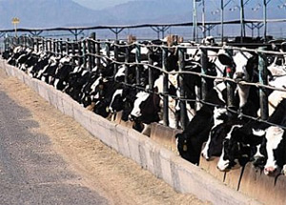
Raw Milk from Conventional Dairies – Not Recommended
Even though populations of pathogens are reduced and even eliminated when added in very large quantities to raw milk, we do NOT recommend consumption of raw milk from confinement dairies.
Under extreme conditions, the multiple anti-microbial components of raw milk may be overwhelmed.

Slide 31
The Money that Pays for Our Food Is a Source of Pathogens
E. Coli has been shown to survive on coins for 7-11 days at room temperature.
Salmonella enteritidis can survive 1-9 days on pennies, nickels, dimes and quarters.
Salmonella enteritidis can also survive on glass and Teflon for up to 17 days.
J Food Protection, 1999;62(7):805-7.
Notes:
Speaking Points: We are always exposed to pathogens!
Full Citations:
Jiang, Xuiping; Doyle, Michael, “Fate of Escherichia coli O157:H7 and Salmonella Enteritidis on Currency,” Journal of Food Protection 1999;62(7):805-7.

Slide 32
Soy Products Contain Pathogens
1998 survey looked at four brands of soy milk; five types of microorganisms found in stored soy milk samples. During storage at 5°C, microbial counts increased sharply after 2-3 weeks.¹
1978 survey found Salmonella in many “health food” products, including soy flour, soy protein powder and soy milk powder. “The occurrence of this pathogen in three types of soybean products should warrant further investigation of soybean derivatives as potentially significant sources of Salmonella.”²
1. J Food Protection, 1998; 61(9):1161-1164.
2. Applied & Environmental Microbiology, Mar 1979; 37(3):559-566.
Notes:
Speaking Points: Pathogens have been found in supposedly sterile soy products, and levels increase with increased time on the shelf.
Full Citations:
1. Bai, Yong; Wilson, Lester; et al, “Quality of commercial shelf-stabel soymilk products,” Journal of Food Protection, 1998;61(9):1161-1164.
2. Andrews, W.H.; Wilson, C.R.; et al, “Bacteriological Survey of Sixty Health Foods,” Applied & Environmental Microbiology, Mar 1979; 37(3):559-566.

Slide 33
Pathogens in Pasteurized Orange Juice
The FDA has ruled that all juice should be pasteurized, because raw juice might be a source of pathogens.
Yet researchers have found fungus that is resistant to pressure and heat in processed fruit juices.
One study found that 17% of Nigerian packages of orange juice and 20% of mango and tomato juices contained heat resistant fungi.¹
Researchers also found E. coli in the orange juice that was pressure resistant and had survived pasteurization.²
In one study, heat-treated and acid-hydrolyzed orange juice was tested for mutagenic activity. The authors hypothesized that the heating process produces intermediate products, which under test conditions, give rise to mutagenicity, and cytotoxicity.³
In another study, gel filtration and high performance liquid chromatography were used to obtain mutagenic fractions from heated orange juice.⁴
1. Int J Food Sci Technology Oct 1995 30(5):587-590.
2. J Food Prot 1999 Mar 62(3):277-9.
3. Food-Chem 1989 31(4):289-294.
4. Food-Chem 1993 46(1):77-79.

Slide 34
Breast Milk Contains Pathogens
MISCONCEPTION: Until recently, the medical profession claimed that breast milk was sterile.
PATHOGENS: We now know that breast milk contains pathogens, often at very high levels.
IMMUNITY FOR LIFE: The bioactive components in milk program the baby to have immunity for life to any pathogens he comes in contact with.
PASTEURIZE BREAST MILK? Should mothers be required to pasteurize their own milk before giving it to their babies?
DISCRIMINATION: Laws prevent mothers from obtaining raw milk to feed their babies should their own supply be inadequate.
5. Scientific American, December 1995.
6. Lancet. 1984 Nov 17;2(8412):1111-1113.
7. Cent Afr J Med. 2000 Sep;46(9):247-51.
8. Eur J Pediatr. 2000 Nov;159(11):793-7.
9. J Dairy Sci 1991;74:783-787.
1. J Appl Microbiol. 2003;95(3):471-8.
2. Neonatal Netw. 2000 Oct;19(7)21-5.
3. J Hosp Infec. 2004 Oct;58(2):146-50.
4. Curr Med Chem. 1999 Feb;6(2):117-27.
Notes:
Speaking Points:
Full Citations:
1. Heikkila, M.P.; Saris, P.E.J., “Inhibition of Staphylococcus aureus by the commensal bacteria of human milk,” Journal of Applied Microbiology, 2003;95(3):471-8.
2. Dougherty, Dorothy; Giles, Valerie, “From Breast to Baby; Quality Assurance for Breast Milk Management,” Neonatal Network, 2000 Oct;19(7)21-5.
3. Ng, D.K.; Lee, S.Y.R.; et al, “Bacteriological screening of expressed breast milk revealed a high rate of bacterial contamination in Chinese women,” Journal of Hospital Infections, 2004 Oct;58(2):146-50.
4. Newburg, David, “Human milk glycoconjugates that inhibit pathogens,” Current Medical Chemistry, 1999 Feb;6(2):117-27.
5. Newman, Jack, “How Breast Milk Protects Newborns,” Scientific American, 1995 Dec, p76.
6. Narayanan, Indira; Murthy, N.S.; et al, “Randomised controlled trial of effect of raw and holder pasteurised human milk and of formula supplements on incidence of neonatal infection,” The Lancet, 17 NOV 1984;2(8412):1111-1113.
7. Igumbor, E. O.; Mukura, R.D.; et al, “Storage of breast milk: effect of temperature and storage duration on microbial growth,” Central African Journal of Medicine, 2000 Sep;46(9):247-51.
8. Ogundele, Michael, “Techniques for the storage of human breast milk: implications for anti-microbial functions and safety of stored milk,” European Journal of Pediatrics, 2000 Nov;159(11):793-7.
9. Zapico, P.; Gaya, P; et al, “Influence of breed, animal, and days of lactation on lactoperoxidase system components in goat milk,” Journal of Dairy Science, 1991;74:783-787.

Slide 35
Pasteurization Reduces Protective Effects of Breast Milk
1984 study involving high-risk premature infants
Lancet. 1984 Nov 17;2(8412):1111-1113
Type of Milk | Rate of infection
Pasteurized human milk + formula | 33.0%
Raw human milk + formula | 16.0%
Pasteurized human milk | 14.3%
Raw human milk | 10.5%
Notes:
Speaking Points: When human breast milk is pasteurized, more babies get sick.
Full Citations:
Narayanan, Indira; Murthy, N.S.; et al, “Randomised controlled trial of effect of raw and holder pasteurised human milk and of formula supplements on incidence of neonatal infection,” The Lancet, 17 NOV 1984;2(8412):1111-1113.

Slide 36
Pasteurizing Breast Milk Puts Infants at Risk!
A recent outbreak of Pseudomonas aeruginosa in a neonatal intensive care unit caused by a contaminated milk bank pasteurizer resulted in 31 cases of infection and four deaths.
Arch Dis Child Fetal Neonatal Ed, 2003 Sep;88(5):F434-5.
Notes:
Speaking Points:
Full Citations:
Guen, C Gras-Le; Lepelletier, D; et al, “Contamination of a milk bank pasteuriser causing a Pseudomonas aeruginosa outbreak in a neonatal intensive care unit,” Archives of Disease in Childhood Fetal and Neonatal Edition, 2003 SEP; 88(5):F434-5.

Slide 37
Some Outbreaks Due to Pasteurized Milk
1976—1 outbreak Y. enterocolitica in 36 children, 16 of whom had appendectomies, due to pasteurized chocolate milk¹
1982—172 cases, 100 hospitalized, Y. enterocolitica in several states from milk produced in Memphis, TN²
1983—1 outbreak, 49 cases, 14 deaths from L. monocytogenes in MA²
1984-85—3 outbreaks of antimicrobial-resistant S. typhimurium, at plant in Melrose Park IL.The third wave had 16,284 confirmed cases; surveys indicated as many as 197,581 persons may have been affected²
1985—1,500+ cases, Salmonella culture confirmed, in Northern IL²
1993-94—1 outbreak, 2014 cases/142 confirmed S. enteritidis due to pasteurized ice cream in MN, SD, WI⁶
1995—Outbreak of Yersinia enterocolitica in 10 children, 3 hospitalized due to post-pasteurization contamination⁷
2000—1 outbreak, 98 cases/38 confirmed S. typhimurim in PA and NJ⁸
2005—1 outbreak, 200 cases C. jejuni in CO prison⁹
2006—1 outbreak, 1592 cases/52 confirmed C. jejuni infections in CA¹⁰
2007—1 outbreak, 3 deaths from L. monocytogenes in MA.¹¹
2009—1 outbreak, 7 deaths from pasteurized milk cheese in Europe.
Notes:
Full Citations:
1. (1976) Black, R.E.; Jackson, R.J.; et al; “Epidemic Yersinia enterocolitica infection due to contaminated chocolate milk,” New England Journal of Medicine, January 12, 1978; 298(2):76-79. Milk was purchased in school cafeterias; investigation suggested that the bacterium was introduced at the dairy during the mixing by hand of chocolate syrup with previously pasteurized milk.
2. (1982) Segal, Marian; “Invisible villains; tiny microbes are biggest food hazard,” FDA Consumer, JUL-AUG 1988; http://www.cfsan.fda.gov/~mow/chap5.html.
3. (1983) Fleming, D.W.; Cochi, S.L.; et al; “Pasteurized milk as a vehicle of infection in an outbreak of listeriosis,” New England Journal of Medicine, 1985 FEB 14; 312(7):404-407.
4. (1984-1985) Ryan, C. A.; Nickels, M. K.; et al; “Massive outbreak of antimicrobial-resistant salmonellosis traced to pasteurized milk,” Journal of the American Medical Association, 1987;258:3269-74. Two surveys to determine the number of persons who were actually affected yielded estimates of 168,791 and 197,581 persons, making this the largest outbreak of salmonellosis ever identified in the United States.
Details of three outbreaks:
1984-AUG, 1 outbreak of S. typhimurium, ~200 cases
1984-NOV, 1 outbreak S. typhimurium,
1985-MAR, 1 outbreak S. typhimurium, 16,284 confirmed cases
5. (1985) Centers for Disease Control and Prevention, “Milk-Borne Salmonellosis—Illinois,” Morbidity & Mortality Weekly Report, 1985 APR 12; 34(14):200. http://www.cdc.gov/MMWR/preview/mmwrhtml/00000520.htm
6. (1993-1994) Centers for Disease Control and Prevention, “Outbreak of Salmonella enteritidis Associated with Nationally Distributed Ice Cream Products--Minnesota, South Dakota, and Wisconsin, 1994,” Morbidity & Mortality Weekly Report, 1994 OCT 14; 43(40). http://vm.cfsan.fda.gov/~mow/salice.html; accessed 28 May 2007
7. (1995) New Zealand PDF: http://www.nzfsa.govt.nz/science/data-sheets/yersinia-enterocolitica.pdf which mentions “10 cases, 3 hospitalised, 1 appendectomy. Control measure failure: post pasteurisation contamination.” US reference is Robbins-Browne, R. (1997) Yersinia enterocolitica. In Food Microbiology: fundamentals and frontiers, (Eds) Doyle, M.P., Beuchat, L.R. and Montville, T.D. pp192-215. ASM Press, Washington, D.C., USA.
8. (2000) Olsen, Sonja J.; Ying, Michelle; et al; “Multidrug-resistant Salmonella Typhimurium infection from milk contaminated after pasteurization,” Emerging Infectious Diseases [serial on the Internet], 2004 MAY; available at http://www.cdc.gov/ncidod/EID/vol10no5/03-0484.htm, accessed 28-May-2007.
9. CDC 2005 Summary Statistics, http://www.cdc.gov/foodborneoutbreaks/us_outb/fbo2005/2005_Linelist.pdf. Also mentioned briefly in State of Colorado Laboratory Services Division 2005-2006 Annual Report, page 17, http://www.cdc.gov/foodborneoutbreaks/us_outb/fbo2005/2005_Linelist.pdf (“The Environmental Microbiology Laboratory recovered Campylobacter from milk samples in the Colorado prison system.”)
10. (2006) Yuan, Jean W.; Jay, M.T.; et al, “Campylobacteriosis Outbreak Associated with Pasteurized Milk — California, May 2006,” Epidemic Intelligence Service Conference 2007 (CDC), 2007 APR 16; page 62. Available at http://www.cdc.gov/eis/conference/archives/EIS_program%20indd.pdf, accessed 28-May-2007. This was a paper presented at a conference.
11. Associated Press, January 8, 2008

Slide 38
Milk Safety in California
ORGANIC PASTURES: Since 1999, over 40 million servings of Organic Pastures raw milk, not one confirmed illness; in over 1,300 tests, not one proven illness and no pathogens found in the milk or milking area, or in any of the dairy cows being milked on the farm.
CLARAVALE: In Claravale Farm’s 80-year history, no consumers of their milk have ever gotten sick from milk-borne pathogens and no pathogens have ever been detected in the milk.
PASTEURIZED OUTBREAKS: Since 1999, several pasteurized milk products recalled and one publicized outbreak of illness due to pasteurized milk during the same period, an outbreak of Campylobacter that sickened 1,300 inmates in 11 state prisons.
http://www.campylobacterblog.com/2006/06/articles/campylobacter-watch/spoiled-milk-apparently-sickened-1300-inmates-at-11-prisons/
Notes:
Speaking Points:
Full Citations:

Slide 39
Bias in Reporting Safety of Raw Milk I
1983 OUTBREAK of Campylobacter infection in Atlanta, GA blamed on raw milk.
EXTENSIVE TESTING failed to find Campylobacter or any other pathogens in any milk products from the dairy. All safety measures had been followed faithfully.
AUTHORS’ CONCLUSION: “The only means available to ensure the public’s health would be proper pasteurization before consumption.”¹
RAW MILK BANNED in Georgia as a result of this incident.
Am J Epidemiol. 1983 Apr;117(4):475-83.
Notes:
Speaking Points: Bias is obvious in many studies the government uses to argue against raw milk. This study led to laws banning the sale of raw milk in the state of Georgia.
Ron Hall, an Australian microbiologist who has worked in the dairy industry for 40 years, says that “the natural habitat for Campylobacter is water, and it contaminates foods, particularly cooked foods, from the use of poor quality water and incorrectly washed and cleaned food processing equipment. Most scientists and food regulators have no scientific knowledge of automated cleaning systems for food factories. Water-loving bacteria such as the pathogen Campylobacter thrive in seals and dead spots in the equipment that are not adequately cleaned and sanitized.”
Full Citations:
Potter, Morris E.; Blaser, Martin J.; et. al. Human Campylobacter Infection Associated with Certified Raw Milk, American Journal of Epidemiology Vol. 117, No. 4: 475-483 . Abstract on line here: http://aje.oxfordjournals.org/cgi/content/abstract/117/4/475.

Slide 40
Bias in Reporting Safety of Raw Milk II
OUTBREAK: November 2001 outbreak of Campylobacter in Wisconsin blamed on raw milk from a cow-share program in Sawyer County. The farm has an outstanding safety record.
OFFICIAL REPORT: 75 persons ill.¹
INDEPENDENT REPORT: Over 800 ill during 12 weeks following Nov 10, 2001.
HAMBURGER LIKELY CAUSE: Only 24 of 385 cow-share owners became ill. Most had consumed hamburger at a local restaurant. No illness in remaining 361 cow-share owners.
BIAS: Local hospitals tested only those who said they had consumed raw milk; others sent home without investigation, so mostly raw milk drinkers included in report.
LAB TESTS CLEAN: Independent lab tests found no Campylobacter in the milk.²
1. MMWR 2002 JUN 28;51(25):548
2. http://www.realmilk.com/pr_071402.html
Notes:
Speaking Points: This outbreak in Wisconsin was all over the news. The government excluded the hundreds of sick people who did not drink raw milk from their statistics.
Full Citations:
1. MMWR 2002 JUN 28;51(25):548
2. http://www.realmilk.com/pr_071402.html

Slide 41
Bias in Reporting Safety of Raw Milk III
CDC REPORT: In 2002, an outbreak of Salmonella Typhimurium implicated raw milk purchased at a dairy producing certified milk in Ohio.¹
SOURCE NOT DETERMINED: According to the CDC: “The source for contamination was not determined; however, the findings suggest that contamination of milk might have occurred during the milking, bottling or capping process.”
MANY POSSIBLE SOURCES: There were many possible of vectors of illness on the dairy besides raw milk.
COINCIDENCE? The outbreak came just a week after the Ohio Farm Bureau Federation voted in favor of raw milk.
NO MORE RAW MILK SALES: The dairy, which had been in business for decades without incident, caved in to health department pressure.
1. MMWR 2002 JUN 28;51(25):548
2. http://www.realmilk.com/pr_071402.html
Notes:
Speaking Points: This outbreak, whose cause was never determined, led to the closing of the last remaining raw milk dairy in Ohio.
Full Citations: 1. MMWR 2002 JUN 28;51(25):548
2. http://www.realmilk.com/pr_071402.html
1. MMWR 2002 JUN 28;51(25):548
2. http://www.realmilk.com/pr_071402.html

Slide 42
Bias in Reporting Safety of Raw Milk IV
VANCOUVER ISLAND, five children from different families were diagnosed with an infection of E.coli O157:H7 after drinking raw goat’s milk¹
BIAS: The report provides an excellent example of bias. The title, “Escherichia Coli O157 Outbreak Associated with the Ingestion of Unpasteurized Goat’s Milk in British Columbia, 2001” does not reflect the possible sources of infection presented in the report.
SAMPLES: One milk sample found “presumptively” positive after “enrichment” with a testing substance; no E.coli found in samples before “enrichment”; no E.coli found in second sample.
OTHER SOURCES: First child infected had also visited a petting farm (a common source of infection); all children lived on a cooperative farm (where contact with animals was a possible source of infection.) E. coli O157:H7 in water a huge problem in the nearby state of Washington due to run-off from industrial farms. E. coli infection usually comes from hamburger meat.
Canada Communicable Disease Report, 2002 JAN 01; 28-01(01)
Notes:
Speaking Points:
Full Citations:
Public Health Agency of Canada (PHAC), “Escherichia Coli O157 Outbreak Associated with the Ingestion of Unpasteurized Goat’s Milk in British Columbia, 2001,” Canada Communicable Disease Report (CCDR), 2002 JAN 1; 28-01(1):6. Online at http://www.phac-aspc.gc.ca/publicat/ccdr-rmtc/02vol28/dr2801eb.html, accessed 11-Jan-2007

Slide 43
Bias in Reporting Safety of Raw Milk V
North Carolina, 10/2000 – 1/2001, Outbreak of Listeriosis Associated with Homemade Mexican-Style Raw Cheese MMWR July 06, 2001 50(26);560-2; MacDonale and others. Clin Infec Dis. 2005;40(5):677-82
Results probably biased as “During the study, rumors spread that the suspected vehicle of infection was homemade Mexican-style cheese.”
Case patients were almost five times as likely as controls to have eaten hot dogs. The outbreak occurred during a massive recall of Listeria-infected hotdogs (900,000 pounds of hotdogs) in 10 southeastern states.
Raeford Farms barbequed chickens were also recalled at time of outbreak—the company refused to comply with the recall!
Listeria was present in the bulk tank raw milk of a manufacturing-grade dairy equipped only to produced process dairy products; bulk tank raw milk from dairies equipped to sell milk as a beverage did not contain the organism.
Revised milking procedures focusing on thorough cleaning of teats and equipment got rid of Listeria contamination at the manufacturing-grade dairy.
NO PASTEURIZATION WAS NECESSARY to prevent contamination with Listeria.
Raw milk was made a well-publicized whipping boy for widespread contamination problems in other foods.

Slide 44
Bias in Reporting Safety of Raw Milk VI
Virulent E. coli O157:H7 sickens up to 20,000 per year in US and kills several hundred.
Recent outbreak in California traced to contaminated spinach.
California officials blamed illness in 4 children during spinach outbreak on raw milk from Organic Pastures Dairy. Ordered quarantine of all OP raw milk products.
After extensive testing, no E. coli O157:H7 found in OP raw dairy products. Quarantine lifted. OP Dairy paid compensation.
FDA blames illnesses on OP raw milk in slides 56-59 of anti-raw milk PowerPoint.
FDA removes slides after letter from OP president Mark McAffee, who points out errors and reminds FDA officials that they are breaking food liability laws.
Officials still refer to this incident as though OP were to blame.

Slide 45
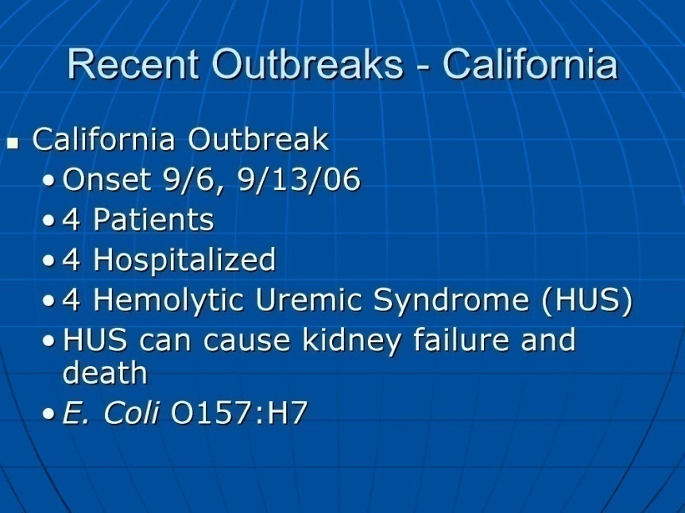
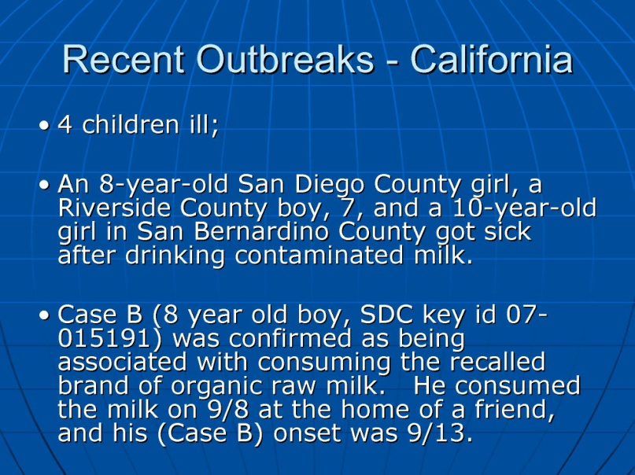
Slides Removed by FDA
FDA removed these erroneous slides after protest by Organic Pastures Dairy
Only two children were hospitalized; they were given antibiotics, which is contra-indicated for E. coli O157:H7 because it leads to HUS.
No pathogens were found in the milk or on the farm, except for in three heifers that were not being milked, and this was of another strain than that which caused the illness.
California Department of Farms and Agriculture made a payment to compensate the dairy for lost business.

Slide 46
Techniques for Blaming Raw Milk
When testing raw milk, use cultures to promote pathogen multiplication and highly sensitive milk testing techniques that find pathogens in extremely small numbers, levels that would not cause illness. (Any substance you test will show pathogens if the test is sensitive enough.)
Use new rapid testing techniques developed for the food industry that err on the side of finding false positives.
When there is an outbreak, use food questionnaires that leave out likely vectors of disease but ALWAYS include raw milk.
When there is an outbreak, test raw milk products first, and test open containers in the home setting rather than from the shelf. If a person is infected and has handled a raw milk product, the product may test positive for the organism. Omit testing other foods or raw milk products on the shelf (not handled by the consumer) but report a positive lab result for the opened container of raw milk product.
Omit subjects who got sick but did not drink raw milk.
Ignore equally likely or more likely sources of infection, such as visit to a farm or petting zoo, tap water or other foods.
Assume that statistical association constitutes proof. It is easy to create a statistical association with raw milk using the above techniques.
Issue inflammatory press releases accusing raw milk, which are not retracted when the dairy is exonerated.

Slide 47
Mis-Information & Dis-Information about Raw Milk
Fallacy of the Modern: Rejection of anything “old” without examination of the details, such as dismissing scientific studies from the 1920s through the 1940s (or even the 1980s) “old science,” as if “old” equals “untrue.”
BROAD BRUSH: For example, claiming that raw milk may harbor a host of disease-causing organisms (pathogens), such as tuberculosis, the bacteria Campylobacter , E. coli 157:H7, Listeria, Salmonella, Yersinia and Brucella.”
CROSS ATTRIBUTION: Associating “listeria” with “drinking raw milk” when it is related to soft cheeses.* Used to magnify and concentrate the effect.
OVERGENERALIZING OR LUMPING: Implying that all serotypes, genotypes, strains, forms, serovars, virotypes, varieties and isolates of a genus or species are pathogenic when in fact many are neutral or beneficial. Has the affect of automatically generating positive test results.
ETIOLOGY IN A VACUUM: Separating the cause & effect relationship from the surrounding conditions (such as blaming raw milk when bad water or exposure to animals is a likely cause). Conjures a mystical fatalism in which the presence of a pathogenic micro-organism is somehow “inherently” dangerous under all conditions.
EITHER-OR REASONING(usually to extremes): Either Raw Milk is a dire threat to public health and must be banned or it must be mass-produced and sold on store shelves at Wal-Marts everywhere. Usually, there are other, and better alternatives to either choice.
Notes:
Fallacy of the Modern is a specific case of Overgeneralization based on technocratic arrogance.
In addition to the BROAD BRUSH:
Note the conditional “may” used to make the statement logically true under any conditions.
Note the pejorative “harbor” used to color the listener’s/reader’s attitude toward the topic
Note the exaggerative “a host” used to magnify the limited list of pathogens and imply large quantities
Note the inclusion of rare (or largely bygone in the U.S.) instances (e.g. yersinia & brucella) to bolster the claim and add to the fear factor
No cases of lysteria poisoning in 12 years attributed to drinking raw milk – Beals 2011

Slide 48
Double Standard for Pasteurized Milk
Feb 24, 2006, Wal-Mart in Vidalia Georgia pulls pasteurized milk from shelves due to foul odor. Foodconsumer.org 28 Feb 06
At least one child seriously sick, not reported in news release. Private communication.
Voluntary recall announced Feb 27, three days later – no sense of urgency.
Wal-Mart applauded by Commissioner Tommy Irvin.
No government recalls; no warnings to the public to avoid drinking pasteurized milk.

Slide 49
Risky Behaviors? More Double Standards
FDA calls drinking raw milk “risky behavior.”
1999 FDA Survey, 19,356 adults, 8 states. Am J Prev Med April 16(3):312-221
50% consumed uncooked eggs
20% consumed pink hamburgers
8% consumed raw oysters
1% consumed raw milk
2008 Study of 4,548 young college students. J Am Dietetic Assoc 108:549-552
53% consumed raw cookie dough
33% consumed eggs with runny yolks
29% consumed raw sprouts
11% consumed raw oysters, clams or mussels
7% consumed rare hamburger
Did not report raw milk consumption
None of the common “risky behaviors” has prominence on FDA’s website for food safety, but raw milk does.
No pasteurization requirement for common “risky behavior” foods.

Slide 50
FDA Powerpoint Warning Against Raw Milk
Posted at www.cfsan.fda.gov/~ear/milksafe, John F. Sheehan, Director, Division of Plant and Dairy Food Safety, contends that pasteurization is the only way to ensure the safety of milk. Of the 15 studies referenced:
No Valid Positive Milk Sample | 12/15 | 80%
No Valid Statistical Association with Raw Milk | 10/15 | 67%
Findings Misrepresented by FDA | 7/15 | 47%
Alternatives Discovered, Not Pursued | 5/15 | 33%
No Evidence Anyone Consumed Raw Milk Products | 2/15 | 13%
Outbreak Did Not Even Exist | 1/15 | 13%
Did Not Show that Pasteurization Would Have Prevented Outbreak | 15/15 | 100%
Source: Response to the FDA, www.realmilk.com

Slide 51
William Marler Anti-Raw Milk Paper
Cites 102 papers alleging illness caused by raw milk. 32 were either about illnesses from pasteurized milk or editorials in favor of raw milk! Of the remaining 70:
Either no valid positive milk sample or no valid statistical association | 67/70 (96%)
No valid positive milk sample | 56/70 (80%)
No valid statistical association with raw milk | 43/70 (61%)
Neither association nor milk sample | 35/70 (50%)
No evidence anyone consumed raw milk products | 7/70 (10%)
Statistical associations with other factors discovered but not pursued | 4/70 (6%)
Did not show that pasteurization would have prevented outbreak | 65/70 (93%)
http://realmilk.com/documents/ResponsetoMarlerListofStudies.pdf

Slide 52
CDC Raw Milk “Outbreaks,” 1998-2005
Sloppy table consisting of reports, news items, press releases. Report summary claims “831 illnesses, 66 hospitalizations, one death.” (foodsafety.ksu.edu/articles/384/RawMilkOutbreakTable.pdf)
None of the reports mentions any death!
Either no valid positive milk sample or no valid statistical association | 31/33 (94%)
No valid positive milk sample | 27/33 (82%)
No valid statistical association with raw milk | 26/33 (78%)
Neither association nor milk sample | 21/33 (64%)
Did not provide evidence that pasteurization would have prevented outbreak | 32/33 (97%)
Evidence that pasteurization would not have prevented outbreak | 32/33 (97%)
Outbreak traced to pasteurized milk | 1 (2 reports)
Outbreak traced to pasteurization failure | 1 (cited twice)
Source of Information unpublished or not verifiable | 3

Slide 53
Comparative Safety of Raw Milk I Based on statistics compiled by Dr. Ted Beals
42 government-reported illnesses from raw milk per year for the period 1999-2011. This number includes unconfirmed cases.
According to a 2007 CDC survey, there are about 9 million raw milk drinkers in the US (3.04% of population). (This number is probably higher today.)
Rate of illness from raw milk can be calculated at .00046%. The actual percentage is probably much lower.
There are about 48,000,000 confirmed cases of foodborne infections per year in the US.
Population about 300,000,000
Rate of illness from all foods can be calculated at 16%
Thus, you are at least 35,000 times more likely to contract illness from other foods than from raw milk. PLUS, drinking raw milk protects you against illness from other foods!
Source: http://www.realmilk.com/real-milk-pathogens.html

Slide 54
Comparative Safety of Raw Milk II
Comparing Raw Milk to Other Foods: Between 1998 and 2005, there were over 10,000 documented outbreaks that contributed to 199,263 documented cases of foodborne illness.
Raw milk was associated with 0.4 % of these cases, a number that is probably exaggerated.
There is no way to quantify whether any one of these foods is safer than another from this data, but it is clear from the data that there is no basis for singling out raw milk as “inherently dangerous.”
realmilk.com/documents/SheehanPowerPointResponse.pdf.

Slide 55
Raw Milk Production Today
Compared to 30-50 years ago, dairy farmers today can take advantage of many advancements that contribute to a safe product:
Managed rotational grazing, ensures healthy cows
Understanding of and effective testing for all zoonoses (diseases that cross-infect from animals to humans)
Understanding of how water-borne pathogens get into bulk milk and control measures. Effective cleaning systems.
Refrigerated bulk tanks
Refrigerated transportation
Easier and inexpensive milk testing techniques
Notes:
Speaking Points:
Full Citations:

Slide 56
Swill Milk
During 1800s, the death rate was 50% among urban children drinking “Swill Milk,” that is, milk produced in inner city confinement dairies, from cows fed brewery swill and raised in unimaginable filth. Called “The Milk Problem.”
Water (usually from a well or dam) was often added to milk to make it go further; chalk was sometimes added.
Called “the oldest food fraud” in 1860 and still a problem today. There is a case before the courts in Australia of water deliberately added to milk in 2007!
Schmid, Ron, The Untold Story of Milk, NewTrends Publishing.
Notes:
Speaking Points:
Full Citations:
Schmid, Ron, The Untold Story of Milk, NewTrends Publishing.

Slide 57
The Campaign Against Raw Milk
Mandatory pasteurization first proposed by Abraham Jacobi, known as the father of American pediatrics
Left Berlin for NY after being jailed two years for high treason during political turmoil of the early 1850s; a socialist who corresponded with Karl Marx.
Fought the notion that raw milk was safe for infants.
Worked to convince a skeptical public that heating milk until bubbles appeared would save lives.
Biggest promoter of pasteurization was his close friend and fellow German émigré, Nathan Straus, owner of Macy’s. Invented phrase “Raw Milk Can Kill.”
1892, Straus opened the Straus Pasteurized Milk Laboratory and soon introduced the first low-cost milk depots for the city’s poor.
Early arguments for pasteurization always admitted that certified raw milk was also acceptable. Pasteurized and raw milk coexisted for over 50 years.
Chemical Heritage, Spring 2009, 26-31

Slide 58
1910 New York Milk Committee Conference
Goal: to reach a consensus on how to handle the city’s dairy products
Most participants were opposed to pasteurization and considered certified raw milk superior.
But city officials did not think they could afford the necessary inspection force to safeguard raw milk.
Result: the Committee endorsed pasteurization because “Private companies, particularly larger companies, through their capital investment in pasteurizing technology, would enable the state to supply the guarantee of milk safety without imposing further public costs.
Decision had nothing to do with science, only with fiscal expediency.
Source Nature’s Perfect Food: How Milk Became America’s Drink by Erna DuPuis

Slide 59

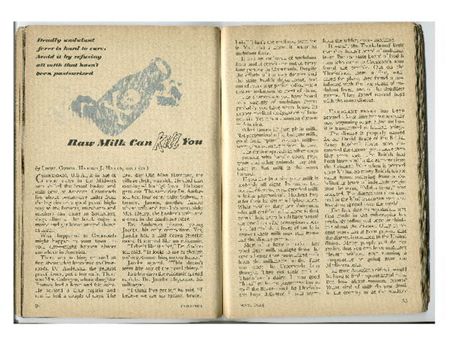
The Campaign Against Raw Milk II Coronet Magazine, May 1945
Article in Coronet Magazine, May, 1945
Seemingly factual article about a town called Crossroads, USA, where many died from undulant fever, contracted from raw milk
One small problem: the whole story was made up, there was no Crossroads, USA, and no outbreak of undulant fever!

Slide 60
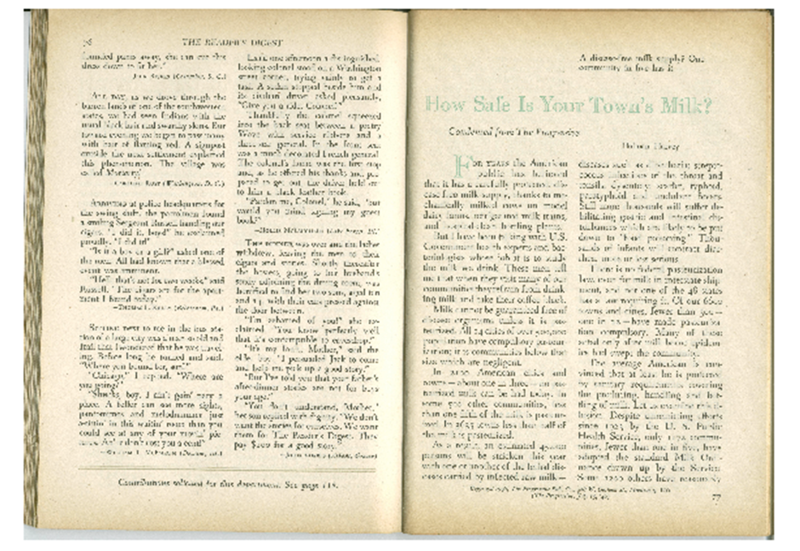
The Campaign Against Raw Milk III
August, 1946, Reader’s Digest repeated false story about Crossroads, USA
Lies about raw milk continue to this day!

Slide 61
Solution to the “Milk Problem”
The “Milk Problem” was solved by:
Outlawing inner city swill dairies
Improved hygiene
Improved water treatment
Replacement of the horse with the car
The Certified Raw Milk movement
Increased consumer access to refrigeration
…NOT by milk pasteurization laws
Notes:
Speaking Points:
Full Citations:

Slide 62
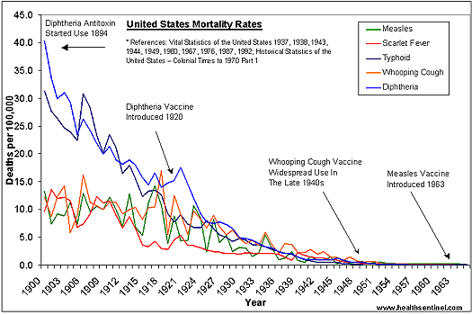
Decline of Infectious Disease Not Related to Mandatory Pasteurization
1948: First State Mandatory Pasteurization Laws

Slide 63
Raw Milk or Bad Water?
CHICAGO STUDY: Study of decline in Chicago mortality rates, 1850-1925, looked at three factors:
Milk Laws: 1893, began inspections to ensure milk had enough fat; 1908, law that milk must be pasteurized or certified pathogen-free.
2. Introduction of diphtheria anti-toxin in 1895
3. Improvement in water sanitation: 1893 closure of shoreline water intakes; 1900 opening of Chicago Drainage Channel.
CONCLUSION: The introduction of pure water explains 30-50% of Chicago’s mortality decline; other interventions had much smaller effects.
Death and the City: Chicago’s Mortality Transition, 1850-1925. Working Paper 11427 www.nber.org/papers/w11427.

Slide 64
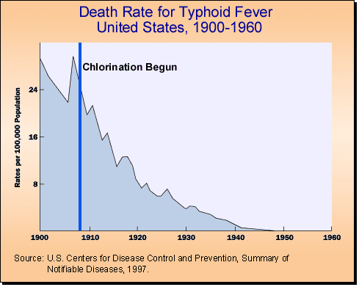
Raw Milk or Bad Water??
1948: First State Mandatory Pasteurization Laws

Slide 65
Heat-Resistant Pathogens in Pasteurized Milk
Johne’s bacteria (paratuberculosis bacteria)– suspected of causing Crohn’s disease, now routinely found in pasteurized milk (19% of samples tested).¹
B. Cereus spores, Botulism spores and Protozoan parasites survive pasteurization.²
Listeria monocytogenes and E. coli O157:H7 survive HTST pasteurization; various Bacillus and Clostridium species may also survive pasteurization.³
Dormancy of heat-treated E. Coli can cause typical laboratory culture techniques to underestimate presence of E. coli in pasteurized milk 100-fold.⁴
1. Appl & Environ Microbiol 2002 May;68(5):2428-35
2. Elliott Ryser. Public Health Concerns. In: Marth E, Stelle J, eds. Applied Dairy Microbiology, New York, Marcel Dekker, 2001.
Binderova and Rysanek. Veterinarni Medicina. 1999;44(10):301-308.
Gunasekera and others. Appl Environ Microbiol. 2002;68(4):1988-1993 (and references therein).
Notes:
Speaking Points:
Full Citations:
1. Grant, Irene; Ball, Hywel; et al, “Incidence of Mycobacterium paratuberculosis in bulk raw and commercially pasteurized cows' milk from approved dairy processing establishments in the United Kingdom,” Applied & Environmental Microbiology, 2002 MAY; 68(5): 2428-2435.
2. Ryser, Elliott, Chapter 13. Public Health Concerns, Applied Dairy Microbiology, Marth, Elmer; Steele, James, Marcel Dekker, New York, 2001, 397,

Slide 66
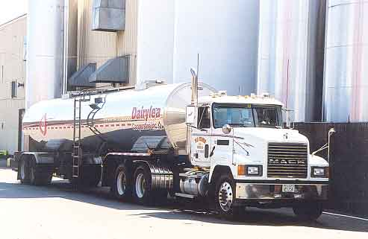
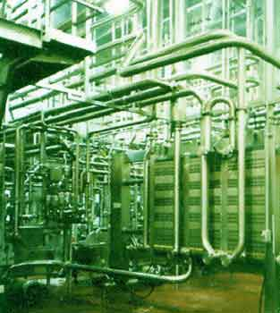
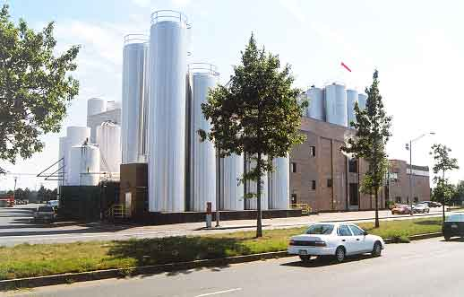
Modern Milk Production
Highly industrialized, with many possibilities for contamination in the feedlots, and during and after processing.
Harsh solvents must be used to clean miles of pipes in the processing plant; impossible to prevent residues from contaminating the milk.
Notes:
Speaking Points: Modern milk is shipped in tanker trucks and processed in large factories where miles of pipes ship the milk through the various high-temperature processes. These pipes must be cleaned out by various solvents and industrial cleaners—and residues invariably end up in the milk.
Full Citations:

Slide 67
Feedlot vs. Pastured Cattle
Studies show that factory-farmed cattle have 300 times more pathogenic bacteria in their digestive tracts than cattle that are allowed to openly graze in pastures.
Peck, John E. “Spinach Crisis Reflects Need For Smaller Farms,” The Capital Times, A8, October 2, 2006
Notes:
Speaking Points:
Full Citations:
Peck, John E. “Spinach Crisis Reflects Need For Smaller Farms,” The Capital Times, A8, October 2, 2006

Slide 68
Summary of Raw Milk Safety
SAFEST FOOD: Raw milk is safer than any other food. It is, after all, the only food suitable for the newborn, and the newborn has no immunity yet.
BUILT-IN SAFETY MECHANISMS: Raw milk is the ONLY food that has build in safety mechanisms.
40-YEAR-OLD SCIENCE: Claims that raw milk is unsafe are based on 40-year-old science.
COURT OF LAW: Claims that raw milk is unsafe would not hold up in a court of law.
RUSSIAN ROULETTE? Drinking raw milk from grass-fed animals is like playing Russian roulette--with no bullets in the chamber.
Notes:
Speaking Points:
Full Citations:

Slide 69
Ensuring Raw Milk Safety
From pasture-fed cows
Full fat
Cows free of TB and undulant fever
Milk produced under sanitary conditions
Milk immediately placed in cold storage
Regular testing program for somatic cell count and pathogens
Regular testing of water on the farm.

Slide 70
Protective Components in Milk Fat
Short and Medium Chain Fatty Acids: Disrupt cell walls of bad bacteria.
Spingolipids: Bind to intestinal cells, prevent absorption of pathogens and toxins.
Arachidonic acid: Helps build gut wall, skin and brain
Fat-soluble vitamins A and D strengthen the immune system.
Pasteurized reduced-fat milk 3-5 times more likely to cause diarrhea in children and the elderly than pasteurized whole milk (Koopman, J S, et al, AJPH, 1984, 74:12:1371-1373 ).
People on lowfat diets tend to have weakened immune systems.
Drink only raw WHOLE milk!!

Slide 71
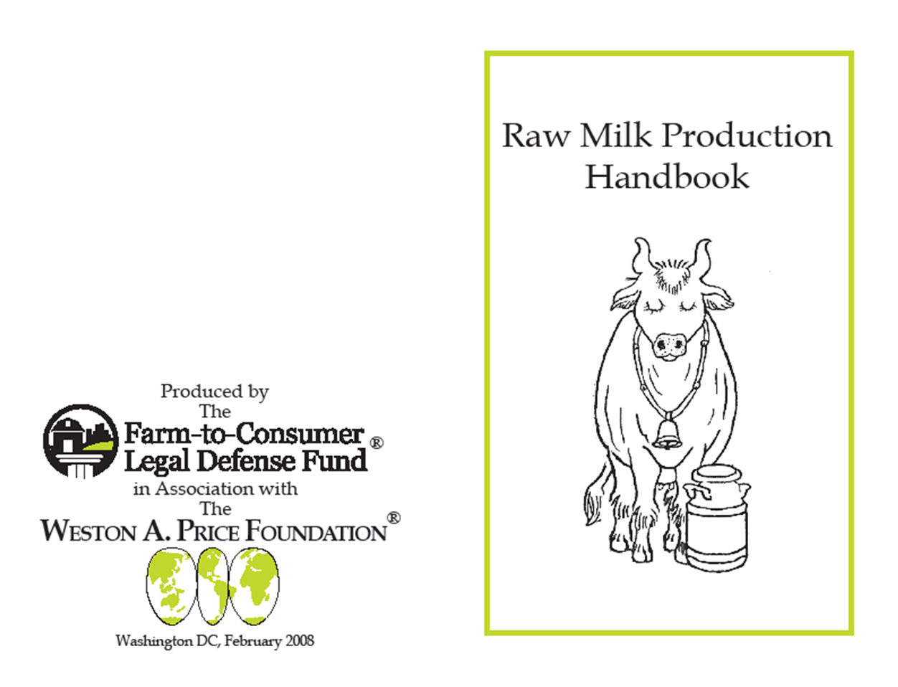
Raw Milk Production Handbook
Excellent resource for safe raw milk production

Slide 72
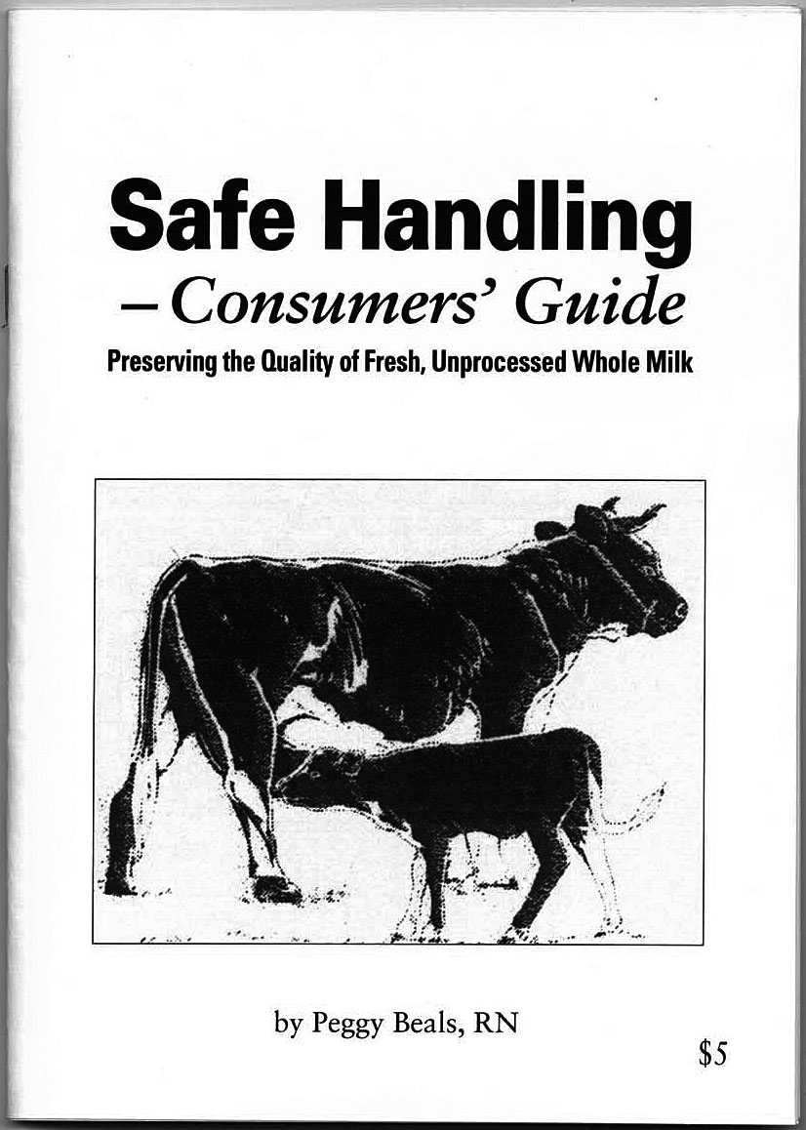
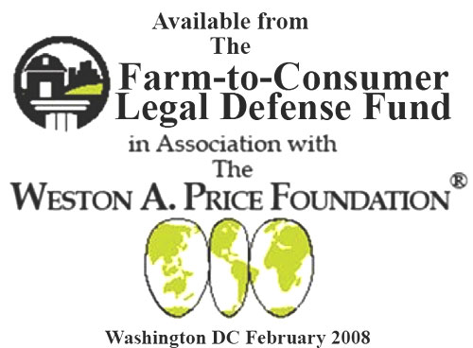
Raw Milk Safe Handling Consumers Guide
Excellent resource for safe raw milk handling in the home

Slide 73
Part 2: Is Raw Milk More Nutritious?
“Research has shown that there is no significant difference in the nutritional value of pasteurized and unpasteurized milk.”
—John F. Sheehan, Director, US Food and Drug Administration, Division of Dairy and Egg Safety
FDA Consumer, Sept/Oct 2004
Notes:
Speaking Points:
Full Citations:
Bren, Linda, “Got Milk? Make Sure It's Pasteurized,” FDA Consumer, SEP-OCT 2004, available from http://findarticles.com/p/articles/mi_m1370/is_5_38/ai_n6198587, accessed 23 May 2007.

Slide 74
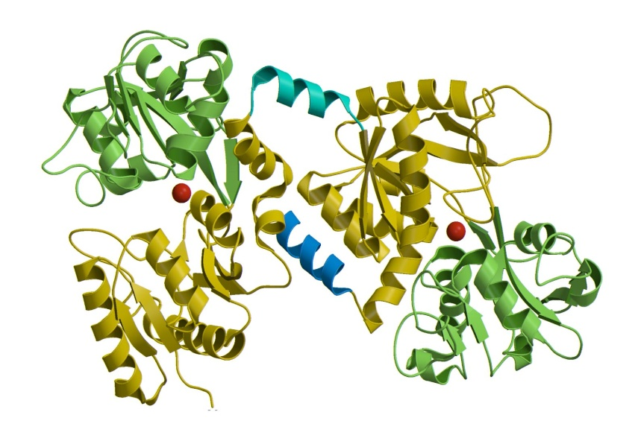
Proteins in Milk
MILK PROTEINS: Three dimensional, like tinker toys, very fragile
CARRIERS: Carry vitamins and minerals through the gut into the blood stream; comprise enzymes; enhance the immune system; protect against disease
IMMUNE DEFENSE: Pasteurization and ultra-pasteurization flatten (de-nature) the three-dimensional proteins, destroying their biological activity; the body thinks they are foreign proteins and mounts an immune defense.
DISEASES: Immune attacks lead
to juvenile diabetes, asthma, allergies
and other disorders later in life.
ALLERGIES: More and more people
unable to tolerate pasteurized milk;
one of the top eight allergies;
some have violent reactions to it.
Lactoferrin Molecule
Notes:
Speaking Points: Pasteurization flattens and destroys the protein components in milk—and most of the protective components are protein compounds. As a result, the body mounts an immune response to pasteurized milk.
Full Citations:

Slide 75
Raw Milk and Children - 1926
STUDY: 224 Children at the Boston Dispensary were fed either:
Raw Certified Milk, or
Grade A pasteurized milk, or
Grade A pasteurized milk plus cod liver oil, or
Raw Certified Milk plus cod liver oil and orange juice
CONCLUSION: “The use of certified milk [raw] without orange juice or cod liver oil gave a considerably greater percentage of weight development than either pasteurized milk alone or pasteurized milk with orange juice and cod liver oil. . . A larger use of certified milk in infant feeding should be encouraged by the medical profession.
Arch Ped 1926 JUN; 43:380
Notes:
Speaking Points:
Full Citations: Arch Ped 1926 JUN; 43:380

Slide 76
Raw Milk and Calcium Assimilation - 1928
COMPARISON: Investigators compared calcium and phosphorus utilization from raw, pasteurized, evaporated and dried milks.
LESS FAVORABLE BALANCES: Researchers obtained “less favorable calcium balances” in adults with pasteurized milk than with “fresh milk.”
GRASS FED SUPERIOR: Milk from cows kept in the barn for five months gave less favorable calcium balances than did “fresh milk.”
Kramer MM and others. Journal of Biological Chemistry 1928;79:283-290

Slide 77
Raw Milk and Children - 1929
COMPARISON of 2 groups of babies.
Group I (122 babies) received raw milk
Group II (112 babies) received pasteurized milk.
WEIGHT GAIN was much better in group receiving raw milk
RICKETS occurred more frequently in the group receiving pasteurized milk; cases of rickets in the raw milk group were milder.
DIARRHEA
24 cases with 9 deaths in raw milk group
36 cases with 15 deaths in pasteurized milk group
MORTALITY
Group I Raw Milk 10%
Group II Pasteurized Milk 16%
Arch Ped 1929; 46: 85
Notes:
Speaking Points:
Full Citations: Arch Ped 1929; 46: 85

Slide 78
Raw Milk and Children – 1931 Bias in Reporting Health Benefits
STUDY: 20,000 poor children (ages 5-12) in Lanarkshire schools in Scotland, funded in part by individuals in the dairy industry.
THREE GROUPS: 5,000 given ¾ pint raw milk per day; 5,000 given ¾ pint pasteurized milk per day; 10,000 received nothing.
“NO DIFFERENCE”: Published final report (Nature, March 21, 1931) stated that those receiving milk had increase in rate of growth and that “the effects of raw and pasteurized milk on growth in weight and height are, so far as can be judged from this experiment, equal.”
“RAW MILK BETTER”: Bias caught by two scientists (Fisher and Bartlett) who published a critical evaluation of the original authors’ conclusions (Nature, April 18, 1931). Growth, especially in boys, was actually better in those receiving raw milk. “Pasteurized milk was only 66 percent as effective in the case of boys and 91 percent as effective in the case of girls in inducing increases in weight; and 50 percent as effective in boys and 70 percent as effective in girls in bringing about increases in height.”
Notes:
Speaking Points:
Full Citations:
Nature, March 21, 1931
Nature, April 18, 1931

Slide 79
Studies of Mattick and Golding - 1931
“Our results show definitely that some dietetic factors are destroyed when milk is sterilised, and to a definite but lesser degree when it is pasteurised, and that although fresh milk is capable of supporting sustained growth and reproduction in rats, heated milk is no longer capable of doing so.”
Mattick EC and Golding J. The Lancet. Mar 22, 1931, p 667.

Slide 80
Rat Studies of Scott & Erf - 1931
By Dr. Ernest Scott and Professor Lowell Erf, Ohio State University, 1931
Jersey Bulletin 1931 50:210-211;224-226, 237
Whole Raw Milk | Good growth; sleek coats; clear eyes; excellent dispositions; enjoyed being petted.
Whole Pasteurized Milk | Rough coats; slow growth; eyes lacked luster; anemia; loss of vitality and weight; very irritable, often showing a tendency to bite when handled.
Notes:
Speaking Points: The interesting thing about this study is the difference in behavior between the rats fed raw and pasteurized milk. Those fed pasteurized milk were very irritable and had a tendency to bite when handled. We have had many parents report much calmer behavior in their children after changing from pasteurized to raw milk. These kinds of changes are what make our mothers so passionate about raw milk. How can our public officials say no to the “passionate moms” who have seen such a better quality of life for their children and themselves just by switching to raw milk?
Full Citations: Jersey Bulletin 1931 50:210-211;224-226, 237

Slide 81
Anemia and Behavior
“Infants with chronic, severe iron deficiency have been observed to display increased fearfulness, unhappiness, fatigue, low activity, wariness, solemnity and proximity to the mother during free play, development testing and at home.”
Anemic infants who did not receive iron supplementation “never smiled, never interacted socially, and never showed social referencing.”
Lozoff B and others. Journal of Nutrition 137:683-689.

Slide 82
Studies of Mattick and Golding - 1935
Rats fed sterilized milk had hair loss; those fed raw milk did not.
Lowered reproductive capacity in rats fed sterilized milk.
“Two females which had received sterilized milk for about eight months showed remarkable improvement after receiving raw milk for about eleven weeks, and one gave birth to a litter when mated to a buck from the raw milk group. Previous to this, 15 matings had been attempted with does and bucks both reared on sterilized milk, and no signs of pregnancy were shown on any one of these occasions.”
Mattick EC and Golding J. The Lancet. Sep 19, 1936, 703-704.

Slide 83
British Orphanage Study - 1937
TWO GROUPS:
Group I: 750 boys got pasteurized milk for 5 years.
Group II: 750 boys got raw milk for 5 years.
RESULTS FOR TB:
Group I had 14 cases of TB
Group II had 1 case.
OTHER BENEFITS: “The child on raw milk is very fit. Chilblains are practically eliminated. The teeth are less likely to decay. The resistance to tuberculosis and other infections is raised.”
Lancet, May 8, 1937:1142

Slide 84
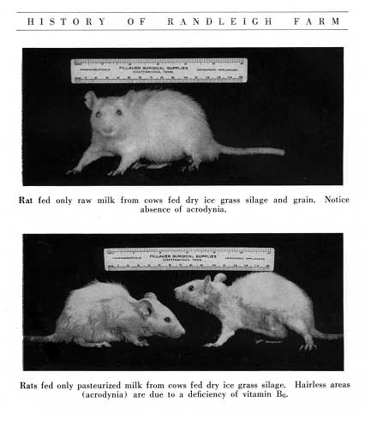
Randleigh Farm Rat Studies – 1935-1940
Raw vs. Pasteurized Milk at Randleigh Farm, 1935-1940
Above: Rat fed only raw milk. Good development, healthy fur.
Below: Rats fed only pasteurized milk. Poor development. Hairless areas (acrodynia) due to deficiency of vitamin B-6.
Notes:
Speaking Points: In studies carried out at Randleigh Farm in the late 1930s, rats fed raw milk thrived, while rats fed pasteurized milk did poorly.
Full Citations:

Slide 85
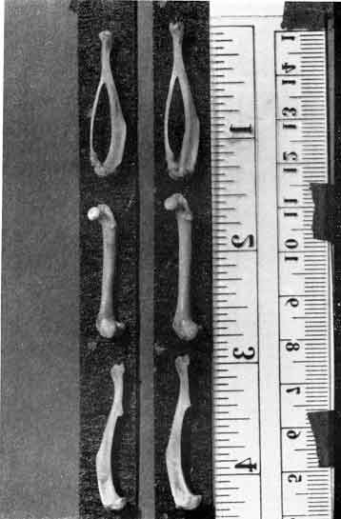
Bone Development
Randleigh Farm Study
One-to-One Exposure of Femur, Tibia and Fibula
PASTEURIZED-Milk-Fed Rat
Weighed 146 grams
Bones shorter and less dense
RAW-Milk-Fed Rat
Weighed 206 grams
Bones longer and more dense
Notes:
Speaking Points: The raw-milk-fed rats had longer and denser bones. Bones are build during the growth period, which is one reason it is so important for growing children to get raw milk.
Full Citations:

Slide 86
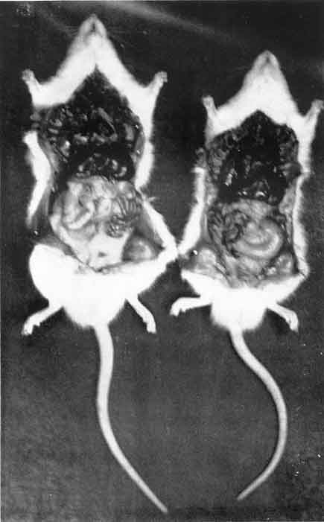
Internal Development
Randleigh Farm Study
Rat fed pasteurized milk had poor color and compromised integrity of internal organs.
Raw Pasteurized
Peritoneal Cavity
Notes:
Speaking Points:
Full Citations:

Slide 87
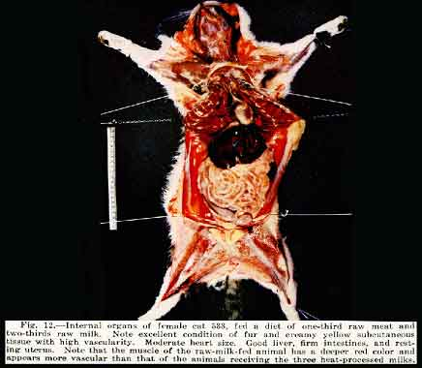
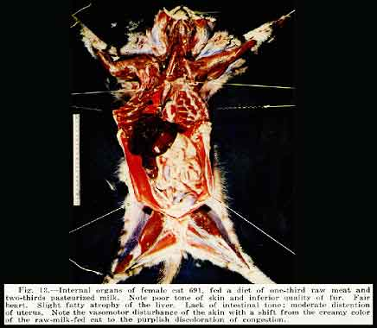
Cat Studies of Francis Pottenger, 1935-1940
Francis Pottenger lecture for Randleigh Farms.
Fig 12. Internal organs of a female cat fed diet of one-third raw meat and two-thirds raw milk. Note excellent condition of fur and creamy yellow subcutaneous tissue with high vascularity. Moderate heart size. Good liver, firm intestines and resting uterus.
Fig 13. Internal organs of female cat fed diet of one-third raw meat and two-thirds pasteurized milk. Note poor tone of skin and inferior quality of fur. Fair heart. Slight fatty atrophy of the liver. Lack of intestinal tone; moderate distention of the uterus. Skin has a purplish discoloration due to congestion.
Notes:
Speaking Points:
Full Citations:

Slide 88
Guinea Pig Studies of Wulzen & Bahrs - 1941
By Dr. Rosalind Wulzen and Alice Bahrs, Department of Zoology, Oregon State College 1941
Am J Physiology 1941, 133, 500
Whole Raw Milk | Excellent growth; no abnormalities
Whole Pasteurized Milk | Poor growth; muscle stiffness; emaciation and weakness; death within one year. Autopsy revealed atrophied muscles streaked with calcification; tricalcium deposits under skin, in joints, heart and other organs.
Notes:
Speaking Points: In this study, the animals fed pasteurized milk ended up with calcium in all the wrong places. Remember that atherosclerosis is a condition of calcium deposits in the arteries. This study raises the possibility that pasteurization of our milk is a contributing factor to the steep rise in heart disease starting in the 1950s.
Full Citations: Am J Physiology 1941, 133, 500

Slide 89
Study on Calves
1941 STUDY carried out at the West of Scotland Agricultural College at Auchincruive.
TWO GROUPS, each of eight calves, were fed, one group on raw milk, the other on pasteurized milk for 90 days
NO DEATHS IN RAW MILK GROUP: All the animals in the raw milk group finished the trial without mortality.
THREE DEATHS IN PASTEURIZED MILK GROUP: In the pasteurized milk group, two died before they were 30 days old, and a third died on the 92nd day; that is two days after the experiment.
ILL HEALTH IN PASTEURIZED MILK GROUP: The remaining calves in the pasteurization group were in ill health at the end of the experiment, while all of the animals in the raw milk group were in excellent health.
JM Mercer. An Experiment in Milk Pasteurization. Nature's Path, March 1941. In Bryant CP. The Truth About Pasteurization, National Nutrition League, Seattle, Washington, 1943.

Slide 90
Raw Milk and Tooth Decay - 1943
Dr. Evelyn Sprawson of the London Hospital:
“. . . In certain institutions, children who were brought up on raw milk. . . had perfect teeth and no decay. The result is so striking and unusual that it will undoubtedly be made the subject of further inquiry.”
James C. Thomson, Pasteurized Milk, A National Menace.
The Kingston Chronicle. Edinburgh, Scotland, 1943,5.

Slide 91
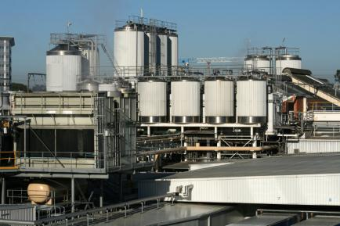
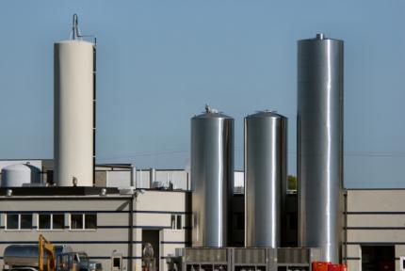
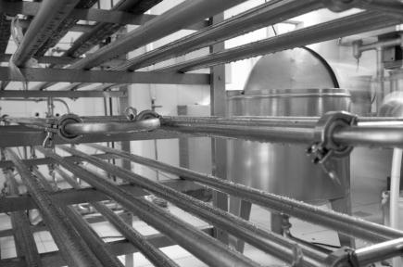
Modern Milk Processing
Notes:
Modern milk is shipped in tanker trucks and processed in large factories where miles of pipes pass the milk through the various high-temperature processes. These pipes must be cleaned out by various solvents and industrial cleaners—and residues invariably end up in the milk.

Slide 92
Pasteurized Milk=Increasing Health Problems in Children
Allergies
Asthma
Frequent Ear Infections
Gastro-Intestinal Problems
Diabetes
Auto-Immune Disease
Attention Deficit Disorder
Constipation
During a period of rapid population growth, the market for fluid pasteurized milk has declined at 1% per year for the past 20 years. Fewer and fewer consumers can tolerate pasteurized (and ultrapasteurized) milk.
Frank Oski, MD, Don’t Drink Your Milk, 1983
Notes:
Speaking Points:
Full Citations:

Slide 93
Other Problems with Industrial Milk
Allowed levels of antibiotics. Only a few of at least 26 types are tested for.¹
No labeling required for rBST.²
Homogenization increases risk of rancidified fats.³
Added Milk Solids and Milk Protein Concentrates.⁴
Does not sour properly but decomposes (putrifies) making it useless for many purposes.⁵
Ultrapasteurized milk cannot be used to make cheese, which means it is indigestible.
Grain fed cattle: implications.⁶
Unsanitary conditions at pasteurized milk producers
Is NOT the same as raw milk nutritionally! (enzymes, proteins, microorganisms)⁷
Notes:
http://www.wthr.com/story/14656493/whats-in-your-milk
http://en.wikipedia.org/wiki/Bovine_somatotropin
http://www.foodsci.uoguelph.ca/dairyedu/grading.html#rancid “It is active at the fat/water interface but is ineffective unless the fat globule membrane is damaged or weakened. This may occur through agitation, and/or foaming, and pumping. For this reason, homogenized milk is subject to rapid lipolysis unless lipase is destroyed by heating first; the enzyme (protein) is denatured at 55-60° C. Therefore, always homogenize milk immediately before or after pasteurization and avoid mixing new and homogenized milk because it leads to rapid rancidity.”
http://www.grist.org/scary-food/2011-09-12-not-your-grandmas-milk
http://en.wikipedia.org/wiki/Clabber_(food)
http://www.eatwild.com/articles/superhealthy.html
See supplemental slides 26 - 34

Slide 94
Infants on Pasteurized Human Milk - 1986
Did not gain weight as quickly compared to those fed raw human milk. J Pediatr Gastroenterol Nutr. 1986 Mar-Apr;5(2):248-53.
More rapid weight gain in premature babies given raw human milk compared to pasteurized human milk. Problems attributed to destruction of lipase. J Pediatr Gastroenterol Nutr. 1986 Mar-Apr;5(2):242-7.
CDC website notes that breast milk is best protection to infants “against salmonellosis and many other health problems.” Yet the agency warns against raw milk as a cause of salmonellosis. Cdc.gov/ncidod/dbmd/diseaseinfo/salmonellosis_g.htm.

Slide 95
The Milk Cure
ANCIENT: Since ancient times, an exclusive raw milk diet has been used to cure many diseases.
MAYO CLINIC: In the early 1900s, the “Milk Cure” was used at the Mayo clinic to successfully treat cancer, weight loss, kidney disease, allergies, skin problems, urinary tract problems, prostate problems, chronic fatigue and many other chronic conditions.
ONLY WITH RAW MILK: The Milk Cure only works with raw milk; pasteurized milk does not have these curative powers.
Crewe, JR. “The Milk Cure,” http://www.realmilk.com/milkcure.html
Notes:
Speaking Points: The Milk Cure only works with raw milk. If you tried a diet of exclusively pasteurized milk, it would make you very sick.
Full Citations: Crewe, JR. “The Milk Cure,” http://www.realmilk.com/milkcure.html

Slide 96
Asthma Crisis
According to the CDC, asthma is the second most prevalent chronic condition among children. It results in approximately 14 million days of missed school each year. Asthma in children increased from 3.6% in 1980 to 7.5% in 1995, or approximately 5 million children.
What if we could prevent most of these cases through something as simple as offering raw milk in childhood?
CDC National Health Interview Survey Data
Notes:
Speaking Points:
Full Citations: CDC National Health Interview Survey Data

Slide 97
Asthma & Raw Milk - 2001
Exposure to farming in early life and development of asthma and allergy: a cross-sectional survey.
Summary: Long-term and early-life exposure to stables and [raw] farm milk induces a strong protective effect against development of asthma, hay fever, and atopic sensitization [rashes].
Lancet. 2001 Oct 6;358(9288):1129-33
Notes:
Speaking Points:
Full Citations: Lancet. 2001 Oct 6;358(9288):1129-33

Slide 98
Asthma & Raw Milk - 2006
Researchers in London concluded that children who even infrequently drank raw milk had significantly less current eczema symptoms and a greater reduction in atopy (allergic hypersensitivity).
J Allergy Clin Immunol. 2006 Jun;117(6):1374-81.
Notes:
Speaking Points:
Full Citations: J Allergy Clin Immunol. 2006 Jun;117(6):1374-81

Slide 99
Asthma & Raw Milk – 2007
In a study of 14,893 children aged 5-13, consumption of raw milk was the strongest factor in reducing the risk of asthma and allergy, whether the children lived on a farm or not.
The benefits were greatest when consumption of farm milk began during the first year of life.
Clinical & Experimental Allergy. 2007 May; 35(5) 627-630.
Notes:
Speaking Points:
Full Citations: Clinical & Experimental Allergy. 2007 May; 35(5) 627-630.

Slide 100
Asthma & Raw Milk – 2011
Children drinking raw milk had 41 percent less asthma and half the rate of hay fever.
Boiling farm milk removed the protective effect.
Protective effect linked to whey proteins in milk, which are damaged by heat.
Journal of Allergy and Clinical Immunology. Online August 29, 2011.
Notes:
Speaking Points:
Full Citations: Clinical & Experimental Allergy. 2007 May; 35(5) 627-630.

Slide 101
Asthma & Foodborne Illness – Relative Risk
About 5,500 people in the US die from asthma each year.
About 1,250 people in the US die from food-borne pathogens from ALL sources. (No deaths from raw milk).
Thus, the risk of dying from asthma is over four times greater than the risk of dying from food-borne pathogens from ALL sources, and infinitely greater than the risk of dying from raw milk.
Notes:
Speaking Points:
Full Citations:

Slide 102
Raw Milk and Glutathione
Glutathione: Key compound for detoxification
High levels in whey protein
Research in 1991 discovered that whey proteins only boost glutathione status in their raw, undenatured state.
Explains the success of the Milk Cure
Source: http://www.westonaprice.org/blogs/cmasterjohn/2010/09/11/the-biochemical-magic-of-raw-milk-and-other-raw-foods-glutathione

Slide 103
Fluorophotometric Demonstration of Orgone Energy in Various Fluids by Wilhelm Reich
Reich considered
fluorophotometric values
an expression of orgone
energy, lumination or life
energy potency.
Milk pasteurized = 55
Milk not pasteurized = +100
The Cancer Biopathy by W. Reich.

Slide 104
Raw Milk Digests Itself!
ACTIVATED ENZYMES: The enzymes in raw milk, when activated by the appropriate pH of the digestive tract, become activated and digest all the components in the milk.
NO WORK: The body’s digestive apparatus does not need to do any work to digest raw milk.
CURATIVE, ENERGIZING: This is a major reason raw milk has such extraordinary healing and energizing powers.
OVERBURDEN: Pasteurized milk puts a huge burden on the digestive apparatus and for many is impossible to digest.
Notes:
Speaking Points:
Full Citations:

Slide 105
Lactose Intolerance
Results from a survey by Opinion Research Corporation (commissioned by the Weston A. Price Foundation) indicate that about 29 million Americans are diagnosed lactose intolerant.
Results from a private survey carried out in Michigan indicate that 82 percent of those diagnosed as lactose intolerant can drink raw milk without problem.
Thus, almost 24 million Americans diagnosed as lactose intolerant could benefit from raw milk.
www.realmilk.com/documents/LactoseIntoleranceSurvey.doc

Slide 106
Raw Milk and Casein Intolerance
Milk allergy is usually attributed to casein intolerance.
Pasteurization destroys L. lactis and other lactic-acid bacteria indigenous to milk.
These bacteria produce enzymes that break down the casein molecule.
These findings suggest that raw milk could be consumed by those with milk allergy, including autistic children.
We have received testimonials indicating that raw milk can be used to treat and even completely reverse symptoms of autism.
Meisel and others. Antonie Van Leeuwenhoek. 1999;76(1-4):207-15

Slide 107
Lowered Nutrient Availability in Pasteurized Milk
Vitamin C | Raw milk but not pasteurized can resolve scurvy. “. . . Without doubt. . . the explosive increase in infantile scurvy during the latter part of the 19th century coincided with the advent of use of heated milks. . .” Rajakumar, Pediatrics. 2001;108(4):E76
Calcium | Longer and denser bones on raw milk. Studies from Randleigh Farms.
Folate | Carrier protein inactivated during pasteurization. Gregory. J. Nutr. 1982, 1329-1338.
Vitamin B12 | Binding protein inactivated by pasteurization.
Vitamin B6 | Animal studies indicate B6 poorly absorbed from pasteurized milk. Studies from Randleigh Farms.
Vitamin A | Beta-lactoglobulin, a heat-sensitive protein in milk, increases intestinal absorption of vitamin A. Heat degrades vitamin A. Said and others. Am J Clin Nutr . 1989;49:690-694. Runge and Heger. J Agric Food Chem. 2000 Jan;48(1):47-55.
Vitamin D | Present in milk bound to lactoglobulins, pasteurization cuts assimilation in half. Hollis and others. J Nutr. 1981;111:1240-1248; FEBS Journal 2009 2251-2265.
Iron | Lactoferrin, which contributes to iron assimilation, destroyed during pasteurization.
Iodine | Lower in pasteurized milk. Wheeler and others. J Dairy Sci. 1983;66(2):187-95.
Minerals | Bound to proteins, inactivated by pasteurization; Lactobacilli, destroyed by pasteurization, enhance mineral absorption. BJN 2000 84:S91-S98; MacDonald and others. 1985.
Notes:
Speaking Points: Milk is a very sensitive substance and its quality depends on the feed of the mothers. Many of the problems people have with commercial milk may be do to allergenic proteins and toxic substances from the feed that end up in the milk.
Full Citations:

Slide 108
Summary
Research has shown that there is a very significant difference in the nutritional value of unpasteurized milk versus pasteurized milk.
Pasteurization of milk is one of the greatest public health disasters in history.
What’s at stake: The health of millions of children worldwide. Raw milk during childhood can mean the difference between a healthy productive life and a miserable life.

Slide 109
Part 3: Is Milk from Pastured Cows More Nutritious?
“Milk is milk and it’s all produced the same way--by cows. .”¹
—Dennis T. Avery, Center for Global Food Issues
1. Global Food Quarterly, December 2002.
Notes:
Speaking Points:
Full Citations: Global Food Quarterly, December 2002

Slide 110
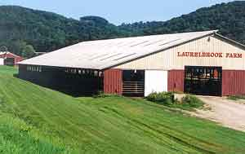
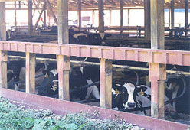
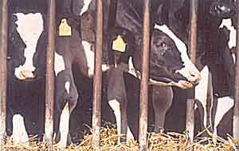
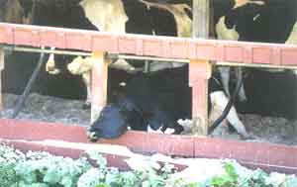
Confinement Dairy System
Cows never leave stalls; life span averages 42 months.
Notes:
Speaking Points: Here we see a typical confinement operation on the east coast. (In the west, and mid-west, they are much larger, sometimes housing up to 2500 cows under one roof.) The cows are inside eating feed completely inappropriate for cows while beautiful green grass grows outside. The average lifespan of cows in confinement is 42 months. Cull cows (photo, lower right) go to hamburger. Most of the hamburger used in fast food restaurants comes from lame and crippled dairy cows.
Full Citations:

Slide 111
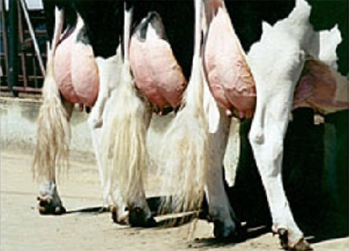
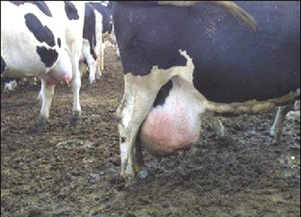
Confinement Dairy System
NOTE: We do NOT recommend raw milk from cows in the conventional dairy system!
Cows bred to have large udders; they are typically milked three times per day.
Notes:
Speaking Points:
Full Citations:

Slide 112
Feed Given to Confinement Cows
Feed | Result in Milk
Soy | Not digested. Soy needs to be fermented for it to become digestible. Allergenic soy protein and estrogenic isoflavones
GMO grains | Aflatoxins (liver poisons)
Bakery waste | Trans fatty acids
Citrus peel cake | Cholinesterase inhibitors (pesticides that act as nerve poisons)
Hormones and antibiotics | Hormones and antibiotics
Pellets from ethanol production! | Chemicals used in ethanol production.
Notes:
Speaking Points: Milk is a very sensitive substance and its quality depends on the feed of the mothers. Many of the problems people have with commercial milk may be do to allergenic proteins and toxic substances from the feed that end up in the milk.
Full Citations:

Slide 113
Ethanol Production and Giant Dairies From the Ohio Farmer, July 12, 2007
Harrison Ethanol's PTI includes construction of a new 2,000-cow dairy facility and a new 10,000-head beef facility. The dairy facility will consist of two freestall barns for housing the dairy cows, with one barn housing 1,332 cows and the other barn housing 668 cows. The beef facility includes eight barns, four receiving barns (each capable of housing 350 head of cattle) and four beef finishing barns (each capable of housing a total of 2,150 head of cattle). Biodigesters will be used to transfer animal waste from the project into either methanol or electric. "Some of the site preparation for the Major Concentrated Animal Feeding Facility was completed in the fall of 2006," said Boggs. "However, that construction has not continued consistently during 2007 at Harrison Ethanol, LLC. Consequently, the farm requested an extension of its PTI, as allowed by department rules. It is our understanding that construction will continue after financing for the project is finalized." The construction of a 12,800-animal facility requires the owners to obtain permits from ODA. Because the farm will exceed 10,000 cattle, it is considered a MCAFF. Harrison Ethanol is a subsidiary of Farmers' Ethanol, LLC.

Slide 114
Adulterated Food Definition
A food shall be deemed to be adulterated:
if:
It bears or contains any poisonous or deleterious substance which may render it injurious to health; but in case the substance is not an added substance, the food shall not be considered adulterated under this subdivision if the quantity of the substance in the food does not ordinarily render it injurious to health.
According to this FDA definition, pasteurized milk is an adulterated food.
But FDA claims that raw milk is an adulterated food!
Notes:
Speaking Points: According to the FDA’s own definition, pasteurized milk is an adulterated food, containing substances that are poisonous and deleterious to health.
Full Citations:

Slide 115
Pasture-Fed versus Stall-Fed
“Milk varies with the season and with the feeding of the cow, especially in regard to vitamin content…the public deserves to have the information that there is a great difference between the milk derived from pasture-fed cattle and that obtained in winter from stall-fed animals, unless particular attention is paid to their diet, and that dirty milk is a menace rather than a blessing.”
American J Public Health 18:634, 1928
Notes:
Speaking Points:
Full Citations: American J Public Health 18:634, 1928

Slide 116
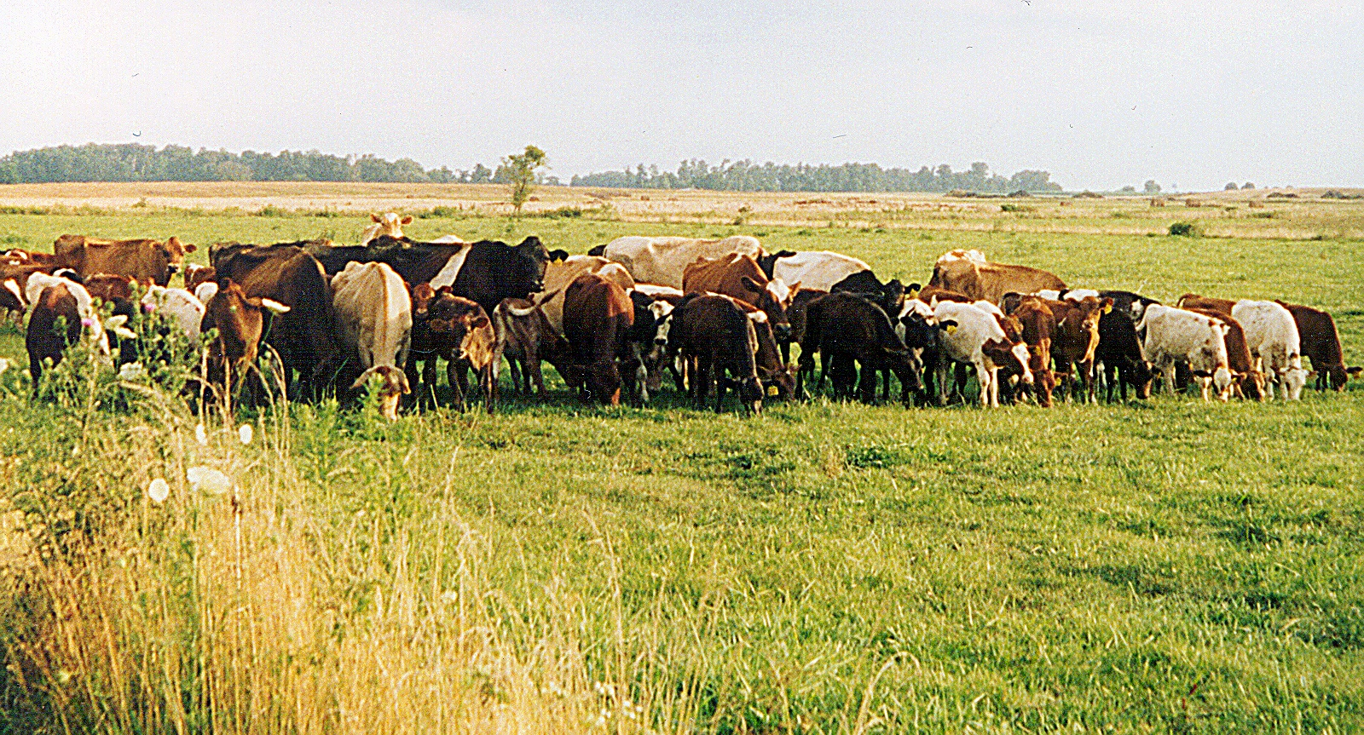
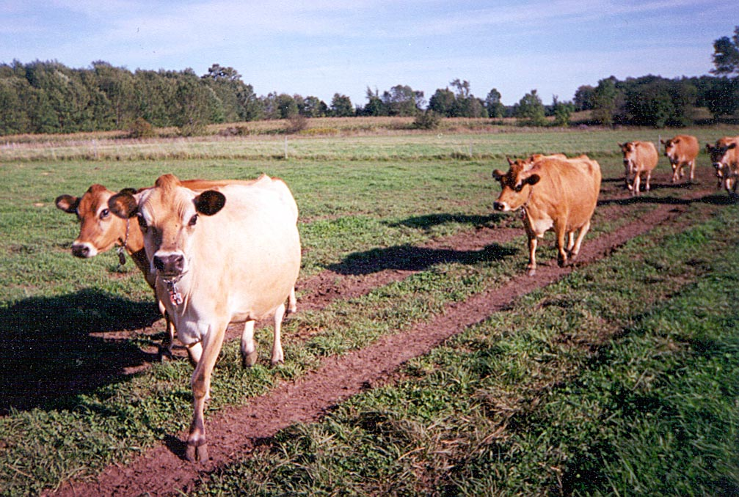
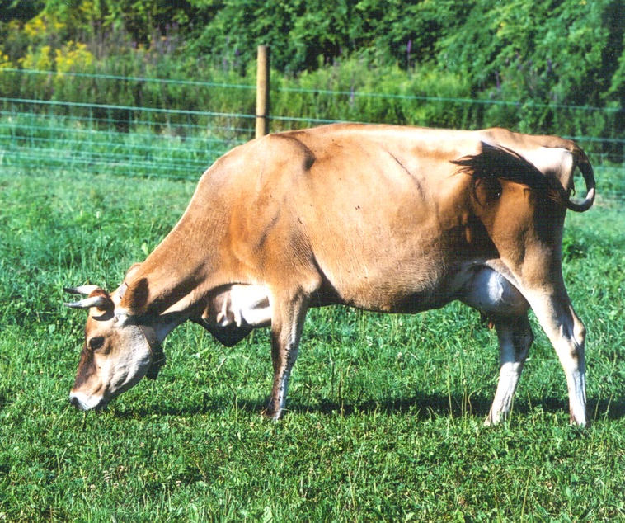
Cows on Pasture
Notes:
Speaking Points: The cow is the perfect machine for turning the nutrients in grass (which is indigestible to humans) into healthy meat and milk.
Full Citations:

Slide 117
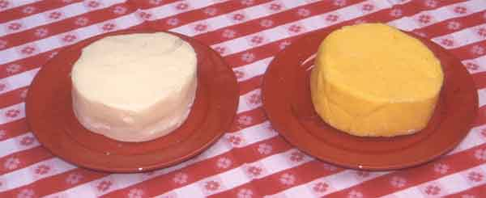
Confinement vs. Grass-Fed Butter
Yellow color of grass-fed butter indicates it is rich in vitamins A, D, and K₂, and Conjugated Linoleic Acid (CLA), a substance that protects against cancer and helps with weight loss.
Notes:
Speaking Points:
Full Citations:

Slide 118
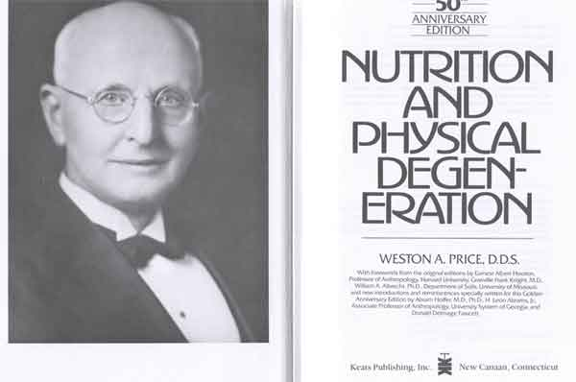
Nutrient Levels in Traditional Diets
The key finding of Dr. Weston A. Price:
Calcium and other Minerals – at least four times higher than the modern diet.
Vitamins A, D and K₂– Ten times higher than the modern diet.
Notes:
Speaking Points: The key characteristic of healthy traditional diets concerns the high levels of nutrients in the foods. This represents the crux of Dr. Price’s research. Two words can sum up Dr. Price’s research—Nutrient Dense.
Dr. Price analyzed the foods of these people in his laboratory. He found that traditional diets contained high levels of minerals—at least 4 times the calcium and other minerals compared to the American diet of his day. This is why organic farming is so important, that is, farming that puts an emphasis on putting nutrients back into the soil. If the minerals are not in the soil, they will not be in the food. That is also why sea foods are important—because they will contain all the minerals that are in the sea.
In addition, primitive peoples prepared their foods so as to make the minerals more available, more easy to assimilate. By contrast, everything we are doing in the West, starting with the way we grow our foods and ending with the way we prepare them, minimizes the nutrients in our foods.
The most surprising finding of Dr. Price was the very high levels of fat-soluble vitamins, meaning vitamins A and vitamin D, in the diets of healthy primitive peoples. These diets contained 10 or more times the levels of vitamins A and D than the American diet of his day. Today there would be an even greater disparity as American avoid the foods that contain these nutrients.
Full Citations:
Weston A. Price, DDS, Nutrition and Physical Degeneration.

Slide 119

Traditional and Modern Face
The body requires high levels of available minerals and vitamins A, D and K₂ starting in utero for wide facial development (on right) and optimum health. Weston Price showed that the modern diet leads to the elongation of the facial structure (on left) and increased susceptibility to disease.
Notes:
Speaking Points:This photograph illustrates perfectly the change in facial structure that occurs when people start to eat western foods. Obviously these two men belong to the same tribe and have the same genetics, but the young man on the right has excellent facial structure, a very broad face, while the young man on the left shows the elongation of the face and the narrowing of the palate that comes with the introduction of western foods. The body has done the best it can with the materials available, but did not have the nutrients needed to build the strong bones that are required for wide dental arches.
While the boy on the right has a bone structure that supports the entire face, it looks as though the face of the boy on the left is actually hanging from the skull.
Round facial development occurs when the diet is rich in fat-soluble vitamins A, D and K.
Full Citations:

Slide 120

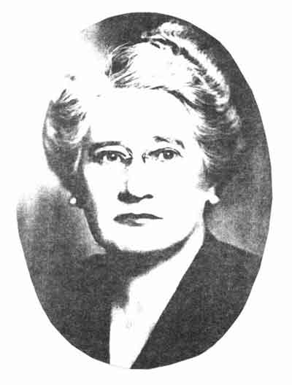
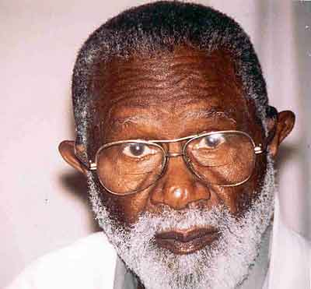
North America
Well-built facial structure of North Americans raised on raw dairy products from grass-fed cows, organ meats, sea food and cod liver oil.
Notes:
Speaking Points:
Full Citations:

Slide 121
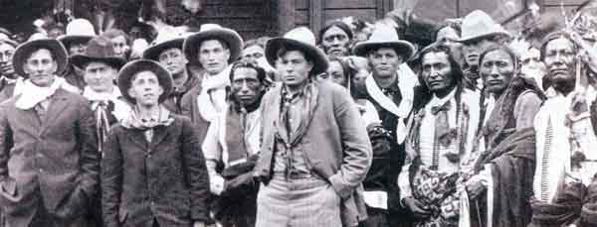
Bill Cody’s Wild West Show, 1910
With one exception (circled in red) all individuals in this photo, both Native and European Americans, have excellent facial structure. Today the individual with good facial structure is the exception. Americans in 1910 drank raw milk from pasture-fed cows.
Notes:
Speaking Points: This is a photograph of is Bill Cody’s Wild West Show, taken in 1910. Both Native Americans and whites have excellent bone structure. There is only one exception, the man whose face is circled. Today the individual with good bone structure is the exception and the narrow face is the norm The Native Americans got their good bone structure by eating buffalo guts and fat but the Americans almost certainly got theirs from raw dairy products from pastured cows along with eggs, liver, bacon and other familiar nutrient-dense foods.
Full Citations:

Slide 122
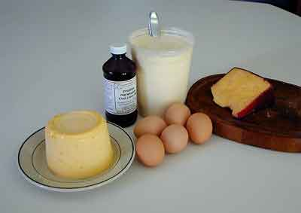
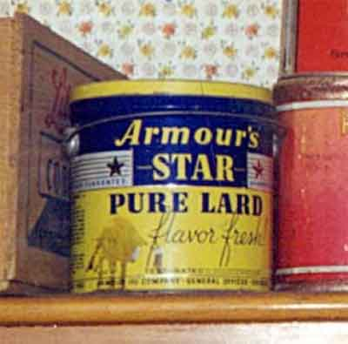
Sources of Vitamins A, D and K₂ in the Traditional American Diet
Butter, cream, cheese and whole milk from grass-fed animals; eggs from pastured-chickens; cod liver oil; lard (vitamin D). Also, liver and other organ meats as in sausage, pate, liverwurst, scrapple, etc.
Notes:
Speaking Points: In the traditional American diet, the chief source of vitamin A was dairy products--milk, butter, cream, cheese and eggs--from animals on pasture. Actually the vitamin A in butter is the easiest to absorb of any food.
One interesting study found that unless the chickens are out in the bright sunlight, there will be no vitamin D in the egg yolks.
Also in the West, we traditionally ate liver once a week. Many western cultures consume liver in the form of pate, liver paste and sausage. Sausage is a way of making offal taste good. We need to return these foods to the American diet.
Until late 1940s, most Americans took cod liver oil and it was routinely given to growing children. Cod liver oil is such a rich source of vitamins A and D, that it acts as an insurance policy for diets that will invariably contain some denatured and devitalized foods.
Our mantra is “cod liver oil and butter from grass fed cows.” These two foods work synergistically and should be part of everyone’s diet, especially that of growing children.
Full Citations:

Slide 123
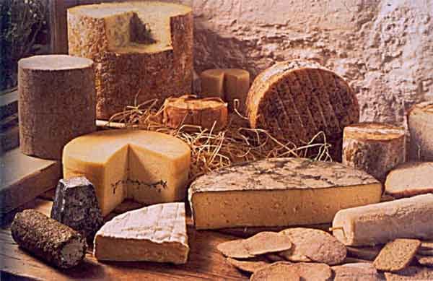
Real (Raw) Cheese from Grass-Fed Cows
The perfect, complete storage food. Contains calcium, phosphorus, CLA, many minerals, B vitamins including B₁₂, vitamins A, D, E, K₂, and even vitamin C.
Notes:
Speaking Points: You cannot obtain raw milk in some parts of the country, but raw cheese is legal everywhere. And even if it is not available in the stores, you can obtain it by mail order. Raw cheese is a complete whole food that provides many nutrients in concentrated form. If it is made from raw milk, it will be very easy to digest.
Full Citations:

Slide 124
Part 4: Is Raw Milk Better for Farmers?
“Farmers who are investing in larger dairy units are undoubtedly those that will remain in dairying for the long haul and are adopting the ‘get big or get out’ attitude.”
John Mahe,Teagasc dairy specialist
Irish Independent, August 19, 2003
“Many of the more than 60,000 dairy farms in the United States have been cutting costs, selling off their cows, or leaving the dairy business altogether as milk prices plummet 35 percent in just the past two months, while dairy farm operating costs remain uncomfortably high. Some farms are losing $200 per head every month.”
U.S. dairy farms in crisis as milk prices turn sour.
Reuters, February 9, 2009
Notes:
Speaking Points:
Full Citations:
Source article can be read at: http://www.accessmylibrary.com/coms2/summary_0286-24157727_ITM (Accessed 02 MAY 2007).

Slide 125
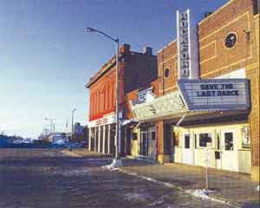
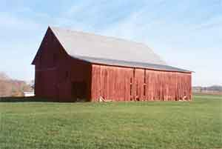
Pasteurization Laws have destroyed rural life
Compulsory pasteurization laws, are largely responsible for the decline of American small towns and rural life.
Pasteurization laws transform what should be a local value- added product that keeps wealth
in the local economy and into
a commodity product that
transfers wealth to large
international corporations.
Source
Notes:
Speaking Points: I have traveled all over the country and seen many burnt out small towns and falling down barns. In Tennessee, for example, there used to be 15,000 dairy farms. Today there are less than 1000 and the landscape is littered with abandoned farms. More than any other factor, compulsory pasteurization law are responsible for the decline of American small towns and rural life.
Full Citations:

Slide 126
Milk Prices – 2007
CONVENTIONAL MODEL
$16-17 per hundredweight
ORGANIC MODEL
$20-25 per hundredweight
RAW MILK DIRECT SALES
$50-$250 per hundredweight
Notes:
Speaking Points:
Full Citations:

Slide 127
Milk Prices – 2009
CONVENTIONAL MODEL
$12 per hundredweight
(Average on-farm cost of production = $15.75)
ORGANIC MODEL
$16 per hundredweight
(Two main organic dairy companies
dropped 10% of their farms in 2009)
Conventional dairy farms, no matter what the herd size,
are losing $1.10 per head per day
RAW MILK DIRECT SALES
$50-$250 per hundredweight
Notes:
Speaking Points:
Full Citations:

Slide 128
Conventional Dairy Farm Economics
30 cows producing 190 hundredweight of milk per year
Farmers receives about $12 per hundredweight – comparable to price received in WW II
GROSS INCOME $68,000 per year
Costs include feed (to get high milk yield), vet bills and replacement cows (average life of cow is 42 months)
In 2002, dairy farms went out of business at a rate of 16 farms per day
Notes:
Speaking Points: Not only has compulsory pasteurization caused many health problems, it has also had a very unfavorable effect on the rural economy.
Pasteurization laws have allowed the dairy industry to become very centralized and monopolistic. Dairy farmers have no say in the price they get for their milk—it is dictated to them by the dairy company that controls their area. The price they get for their milk is so low that the economics just don’t work. Plus, the confinement system meant very high costs. This is why, in 2002, diary farms went out of business at a rate of 16 farms per day.
These are small dairy farms going out of business. The large confinement operations stay afloat because they receive subsidies in various forms.
Full Citations:

Slide 129
Economics of Pasture-Based Mixed Farm with Direct Sales
30 Cows on 100 Acres
Cows produce 100 hundredweight of milk each per year
Farmer sells milk at $5 per gallon and equivalent price for cream, butter and cheese
Gross income from milk and milk products = $150,000
Minimal input for feed, vet bills; no replacement cow costs
PLUS – whey and skim milk used to feed pigs and chickens. Income from eggs, broilers, turkeys, pork, beef, veal and broth = $50,000 with minimal input for feed, etc.
GROSS INCOME $200,000 per year, with much lower costs.
Notes:
Speaking Points: When a farmer sells raw milk directly to the public, he receives a much better price for his milk—anywhere from $4 to $12 per hundredweight. In this slide, we choose the conservative number--$4 per gallon. As you can see, even at this price, the farmer can make a very good living.
You, the consumer, have the opportunity to contribute to a huge rural revival in this country, simply by insisting on purchasing your dairy products, eggs and some of your meat directly from a farmer.
Full Citations:

Slide 130
Conventional Dairy vs Raw Dairy: Conservative Estimate
CONVENTIONAL
30 Cows
200 acres to raise feed
195 hdwt/cow
5460 hdwt total
COST: $15.75/hdwt
PRICE: $13.50/hdwt
GROSS: $74,000
COST: $86,000
Additional Sales: None
NET: Loss of $12,000
GRASS FED RAW MILK
15 Cows
20 acres of pasture
120 hdwt/cow
1440 hdwt total
COST: $30/hdwt
PRICE: $50/hdwt ($5 per gallon)
GROSS: $84,000
COST: $43,000
Additional Sales. Eggs, pork, cows: $15,000
NET: Profit of $55,000
Source: Tim Wightman

Slide 131
The Multiplier Effect
Every $1 earned on the farm = $5-7 for the local community.
If 10% of the population would buy raw milk and other products directly from the farm, we would need 75,000 farms, all making at least $200,000 per year.
Raw milk sales hold the potential for a huge rural revival.
Notes:
Speaking Points:
Full Citations:

Slide 132

Pasture-Based Mixed Farm
Dairy Cows
Fresh Milk $
Butter $
Cream $
Yogurt $$$
Cheese $$$$
Culled Cows $
Purchased Input:
Some grain
Mineral fertilizers
Equipment
Free Input: Sunlight
Whey
Skim Milk
Male
Animals
Beef (& Lamb)
Meat $$
Sausage $$$
Broth $
Hogs
Meat $
Ham $$
Bacon $$$
Sausage $$
Lard $$
Manure
Whey
Skim Milk
Vegetables
Fresh
Vegetables $$
Lacto-
Fermented
Condiments $$$
Greens
$$$
Poultry
Eggs $$
Meat $
Broth $
Foie Gras $$$
Manure
Notes:
Speaking Points: When farmers can sell their products directly to the public, the dairy cow serves as the basis for a prosperous, integrated farm. The cow provides milk for sale and products like butter, cream and cheese. The whey and skim milk left over from making butter, cream, yogurt and cheese is the perfect food for chickens and hogs. The cow is the only animal that feeds not only herself and other people, but also the other animals on the farm. That is why the dairy cow should be the centerpiece of the prosperous integrated farm.
Cow manure makes great compost for the vegetable garden and orchard, and male offspring provide beef and veal. Each one of these components can bring income to the farmer. The major input to this system is sunlight to make the grass grow, which is free.
Of course such a system requires a lot of hard work but the workload can be shared among several families. The main impediment to this wonderful system is health laws which have worked to put thousands of small farms out of business.
Remember it was Karl Marx who urged the industrialization of agriculture, making animals units of production. He recommended “laws creating industrial crimes,” especially for agriculture. This is what we have today, and these laws—making it a crime to sell raw milk—have resulted in the demise of free enterprise on the farm.
Full Citations:

Slide 133
Impediments to Ideal Model
Health Laws
Biased, capricious permitting process
Zoning Laws
National Animal Identification System (NAIS) — The Fulfillment of the Marxist Dream
Looming Food Safety Legislation, HR 2749, S 510—would it give FDA jurisdiction over raw milk sales?
Notes:
Speaking Points:
Full Citations:

Slide 134
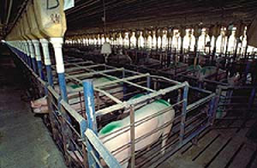
Animals as Units of Production
Key provision of Marx’s Communist Manifesto
Notes:
Speaking Points:
Full Citations:

Slide 135
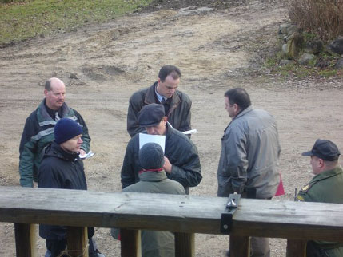
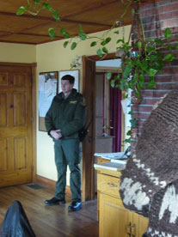
Industrial Crimes, Especially For Agriculture
Another key provision of Marx’s Communist Manifesto
Photos from raid of Michael Schmidt’s farm in Ontario, Canada, November 21, 2006
Notes:
Speaking Points:
Full Citations:

Slide 136
NAIS — The Agenda
NAIS is designed to eliminate grass-based livestock through the enforcement of industrial crimes for agriculture.
It is the industry’s attempt to eliminate the emerging competition from pasture-based farms.
Notes:
Speaking Points:
Full Citations:

Slide 137
The Milk Industry
Concentrated in four companies: Land O’Lakes, Foremost, Dean Foods, Dairy Farmers of America.
CEOs typically make over $1 million per year
Powerful behind-the-scenes lobbying group
Opposes competition of raw milk, especially as it allows farmers to get a higher price for their milk.

Slide 138
Example of Dairy Industry Clout
In January, 2008, Martha Stewart aired a segment about raw milk at Smith Family Farm in Maine.
The milk industry then conducted “outreach” with Stewart to “educate” her on the dangers of raw milk consumption.
“We discussed our concerns with Stewart’s producers at length, and were provided assurances that she will not talk about raw milk throughout her partnership with MilkPEP [Milk Processors Education Program] and additionally, that she will consider changing her overall position and commentary on raw milk in the future.
(Midwest Dairy Association Update, March 2008)

Slide 139
The Good News!
Retail Sales of Raw Milk: Allowed in 8 states (CA, WA, AZ, NM, SC, ME, PA, CT)
On-Farm Sales of Raw Milk: About 28 states.
Raw Milk as Pet Food: Available in 4 states (GA, NC, FL, ND)
Raw Milk widely available through cow-boarding or farm-share agreements in WI, MI, TN, VA, CO, OH, IN.
Worst state laws for raw milk: HI, MD, RI, NJ, NV, ID, WV, IA, MT, WY. (Yet Raw milk from Pennsylvania widely available in MD and NJ.)
Raw milk easily available in about 42 states.

Slide 140
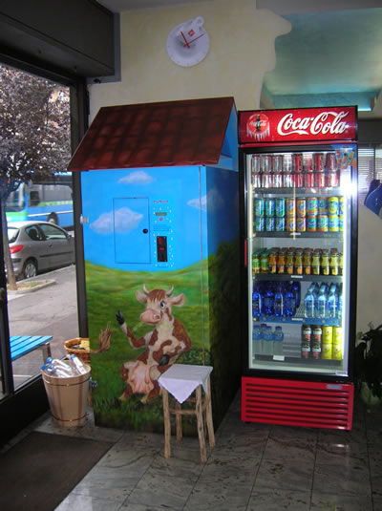


Raw Milk in Europe
Legal in England and Wales – the royal family drinks raw milk!
Widely available in continental Europe through vending machines. . . even in schools!
Hard to get in Scandinavia, Ireland.
Raw milk on the Vittoria Veneto!

Slide 141

Farm-To-Consumer Legal Defense Fund (FTCLDF)
Legal Defense for Small Farmers
Raw Milk Protection
Right to On-Farm Processing and Direct Sales
Legal Opposition to NAIS
Help with farm-share and cow-share programs
Recent legal successes in Ohio, New York, Pennsylvania, California
Website: farmtoconsumer.org
Phone: (703) 208-FARM
Notes:
Speaking Points:
Full Citations:

Slide 142
All truth passes through three stages.
First, it is ridiculed.
Second, it is violently opposed.
Third, it is accepted as self-evident.
—Arthur Schopenhauer
Notes:
Speaking Points: Until recently, authorities merely ridiculed proponents of raw milk. Now that we have amassed so much evidence on the safety and health benefits of raw milk, we are entering into the second stage—violent opposition. But I predict that within 10 years, both health officials and consumers will accept it as self evident that raw milk is a superior food.
The “scientist’s version” of the Schopenhauer quote might be this (as provided by microbiologist Ron Hall):
“Theories have 4 stages of acceptance:
1. This is worthless nonsense;
2. This is an interesting, but perverse, point of view;
3. This is true, but quite unimportant;
4. I always said so.”
Hall attributes this to JBS Haldane in 1963, as well as many other scientists before him.
Full Citations:

Slide 143

Resources
The Weston A. Price Foundation westonaprice.org
Quarterly Magazine
Informational Brochures
Yearly Shopping Guide
Annual Conference
Local Chapters
Notes:
Speaking Points:
Full Citations:

Slide 144


Resources
Healthy Baby Issue Heart Disease Issue

Slide 145
Resources
A Campaign for Real Milk
realmilk.com
A Project of the
Weston A. Price Foundation
Many articles on raw milk and raw cheese; sources for raw milk.
Notes:
Speaking Points:
Full Citations:

Slide 146

Resources
The Untold Story of Milk REVISED AND UPDATED
by Ron Schmid
New Trends Publishing
newtrendspublishing.com
(877) 707-1776
Notes:
Speaking Points:
Full Citations:

Slide 147
Resources
Nutrition and Physical Degeneration
Price-Pottenger Nutrition Foundation
price-pottenger.org
(619) 462-7600
Notes:
Speaking Points:
Full Citations:

Slide 148
Summary
Traditional diets maximized nutrients while modern diets minimize nutrients
TRADITIONAL DIETS MODERN DIETS
Foods from fertile soil Foods from depleted soil
Choice of organ meats over muscle meats Muscle meats, few organ meats
Animal fats Vegetable oils
Animals on pasture Animals in confinement
Dairy products raw and/or fermented Dairy products pasteurized
Grains and legumes soaked/fermented Grains refined and/or extruded
Bone broths MSG, artificial flavorings
Unrefined sweeteners (honey, maple syrup) Refined sweeteners
Lacto-fermented vegetables Canned vegetables
Lacto-fermented beverages Modern soft drinks
Unrefined salt Refined salt
Natural vitamins in foods Synthetic vitamins added to foods
Traditional cooking Microwave, irradiation
Traditional seeds/open pollination Hybrid seeds, GMO seeds
Notes:
Presenter’s Note: Leave this slide on screen during questions and answers.
Speaking Points:
Full Citations:

